Slide 1
New Employee Food Safety Training Guide
Training provided by:
Chatham County Environmental Health

Slide 2
UNIT ONE: Food Safety Basics

Slide 3
What is Food Safety?
The safeguarding and protection of food from anything that could harm consumer’s health.

Slide 4
Food Safety is Important

Slide 5
Impacts of Foodborne Illness
Hospitalizations and Deaths
Lawsuits
Increased insurance rates
Increased food costs
Lower profits
Loss of employment
Business closure

Slide 6
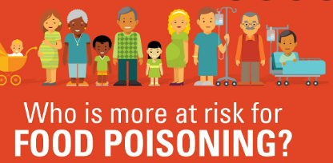
Population most affected by Foodborne Illness
Highly susceptible populations include:
Children,
Older adults
Pregnant
Immunocompromised
Y- young
O-older adults
P-pregnant
I-immune compromised

Slide 7
Top 5 Foodborne Illness Pathogens
Norovirus
Salmonella
Clostridium Perfringens
Campylobacter
Staphylococcus aureus

Slide 8
Preventing Foodborne Illness
Training
Creating a Food Safety Culture is all our responsibility
Follow a set of shared values to produce and provide safe food.
Know the risks associated with food prepared and served.
Know why managing the risk is important.
Demonstrate that risks are effective managed.

Slide 9
Active Managerial Control
The responsibility of providing safe food for the consumer by developing and implementing food safety management systems to prevent, reduce, and eliminate the occurrence of foodborne illness risk factors.
Reasonable care is when management takes all reasonable precautions and care to avoid committing a violation of the FDA FOOD CODE.

Slide 10
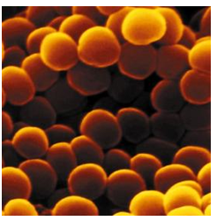
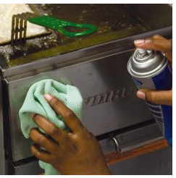
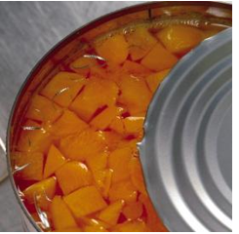
Common Food Safety Hazards
Biological
Bacteria, Fungi, Viruses, Parasites
Chemical
Allergens, Pesticides, Cleaners,
Naturally occurring poison/toxins
Physical
Metal, Glass, Plastic, Rocks, Fingernail, Hair

Slide 11
Most Common Factors Contributing to Foodborne Illness
Food Temperatures
Cooking
Cooling
Hot/Cold Holding
Reheating
Approved Source
Cross-Contamination
Poor Cleaning and Sanitizing
Personal Hygiene

Slide 12
Factors Influencing Pathogen Growth
Food
Acidity
Temperature
Time
Oxygen
Moisture

Slide 13
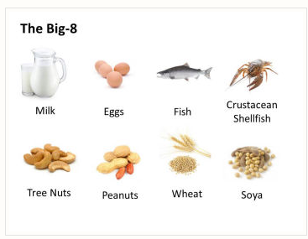
Food Allergens
CDC estimates 15 million people in the US have food allergies including 6 million children
FDA FOOD CODE requires that the food establishment have a person in charge during all hours of operation who is knowledgeable about major food allergens.
Major food allergens
Milk
Eggs
Fish/Shellfish
Tree nuts
Peanuts
Wheat
Soybean

Slide 14
Food Allergens
Food allergy reactions:
Hives, itching, tingling in mouth, swelling of lips, tongue or face, wheezing, trouble breathing, diarrhea, vomiting or dizziness.
Severe allergy reaction-tightening of airways difficulty breathing, shock, loss of consciousness. Anaphylaxis or Anaphylactic shock
Food allergy versus food intolerance:
A food allergy is the body’s immune system having an abnormal reaction to proteins in the food.
A food intolerance is when the digestive system is unable to digest certain food.

Slide 15
Food Allergens
Cross contact occurs when an allergen is inadvertently transferred from a food containing the allergen to a food that does not contain the allergen.
Preventing Cross Contact
Storage-separate and label food with allergens
Handling-clean and sanitize utensils and surfaces after contact with allergens
Cooking surfaces- heat doesn’t eliminate allergens. Clean in between use
Handwashing-frequently during preparation and service
Buffet service-label service utensils and communicate with customers

Slide 16
Food Allergens
Risk Factors
Ingredients with allergens
Processed food that contain allergens
Cross contact
Labeling
At risk populations (YOPI)
Best Practices
Know your ingredients
Prevent cross contact
Labeling allergens, label containers holding allergens

Slide 17
Unit 1- Review
Children are more susceptible to get a foodborne illness than adults. TRUE or FALSE
About 3,000 people die from foodborne illness each year. TRUE or FALSE
Most bacteria require Food, Acidity, Temperature, Time, Oxygen and _______ to grow.
A highly susceptible population include: children, older adults and _________________.
A bone is a chemical food safety hazard. TRUE or FALSE

Slide 18
Unit Review Answers
Children are more susceptible to get a foodborne illness than adults. TRUE
About 3,000 people die from foodborne illness each year. TRUE
Most bacteria require Food, Acidity, Temperature, Time, Oxygen and Moisture to grow.
Highly susceptible population include children, older adults, pregnant, and immunocompromised.
A bone is a chemical food safety hazard. FALSE

Slide 19
UNIT TWO: Purchasing and Receiving Food

Slide 20
Flow of Food
Flow 1-purchasing, receiving, storage, preparing, serving
Flow 2-purchasing, receiving, storage, preparing, cooking, serving
Flow 3-purchasing, receiving, storage, preparing, cooking, holding, serving
Flow 4-purchasing, receiving, storage, preparing, cooking, cooling, reheating, serving
**The greater number of steps, the greater the risk for a food safety hazard to occur.

Slide 21
Purchasing and Receiving: Best Practices
Obtain food from an approved source
An approved supplier is one who is accountable to a Regulatory Authority.
Different foods may require different Regulatory Agencies
Fresh fruits and veggies may require GAP(Good Agricultural Practices) certification
Processed foods may require GMP(Good Manufacturing Practices)
Meat, Poultry, Dairy foods regulated by USDA

Slide 22
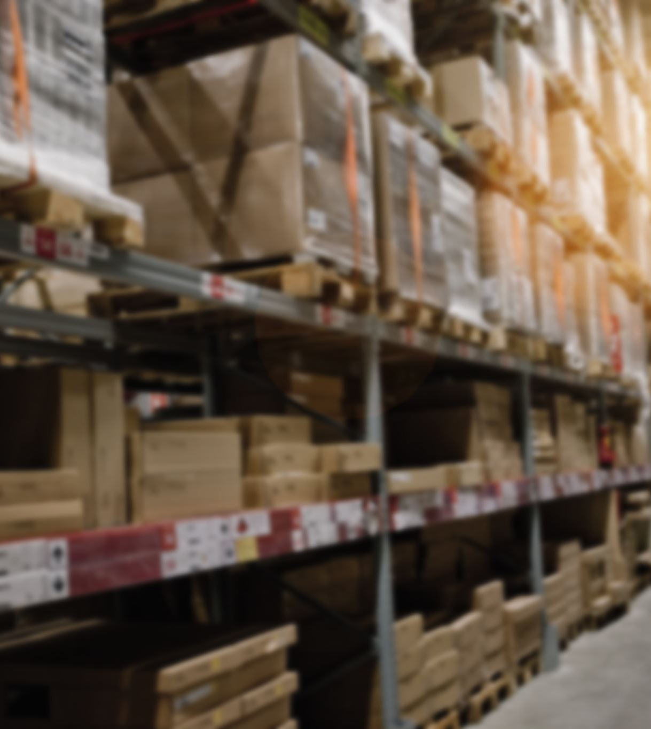
Approved Supply Requirements
Meet Regulatory Standards for operation
Delivery vehicles look and smell clean
Warehouse follow GAP/GMP procedures
Deliveries scheduled at a convenient time for food establishment
Delivery vehicle designed to maintain temperatures frozen solid; 41F or less; 135F or above
Provide written policy for returns/recalls
Packaging is clean/ no damage
No evidence of pests

Slide 23
Purchasing and Receiving: Food Establishment Requirements
Schedule deliveries at convenient time- no overnight drops
Train employees in correct receiving procedures(i.e., reject cold foods not frozen or at 41F or less).
Check invoices
Check temperatures
Check dates
Label items with receive date
Clean area and adequate lighting
Clean equipment(hand trucks, carts)
Move perishable items to storage quickly(freezer/cooler)
Schedule only one supplier at a time
Separate rejected food from accepted food

Slide 24
Reasons for Rejecting Food Deliveries
Improper cold or hot holding
Food is past the use by date
Frozen food has large ice crystals(indicates thawed and refrozen)
Canned food is dented, leaking, swollen ends or no labels
Presence of pests or pest activity
Package damaged, contents leaking
Food does not meet approved specifications
Any food from uninspected home kitchen

Slide 25
Unit 2: Review
You can receive dented cans if only one large dent. TRUE or FALSE
Milk should be checked for temperature before putting into cooler. TRUE or FALSE
Frozen food with ice crystals can be placed into the freezer immediately. TRUE or FALSE
Gnaw marks on food packaging is a sign of pest activity and food should be rejected. TRUE or FALSE

Slide 26
Unit Review Answers
You can receive dented cans if only one large dent. FALSE
Milk should be checked for temperature before putting into cooler. TRUE
Frozen food with ice crystals can be placed into the freezer immediately. FALSE
Gnaw marks on food packaging is a sign of pest activity and food should be rejected. TRUE or FALSE

Slide 27
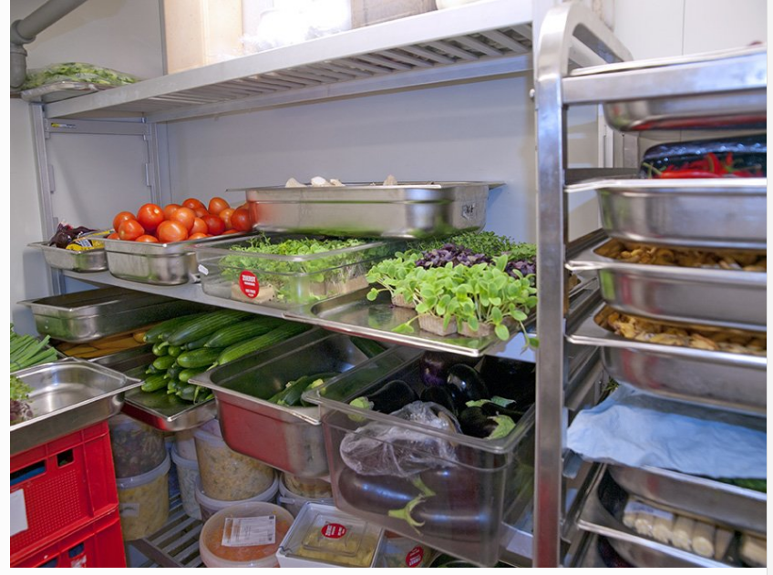
UNIT THREE: Storage

Slide 28
Food Storage
Improper storage can affect food quality and result in food waste due to spoilage.
Improper storage can increase the risk of cross- contamination and potential for foodborne illness.

Slide 29
Time Temperature Control for Safety(TCS)
TCS food is one that requires strict control of time and temperature during storage, cooking, cooling, holding to limit pathogen growth and/or toxin formation.
Is the food a TCS food?
Acidity
Water Activity(Aw)
Combination of Acidity and Water Activity
Cooking
Packaging

Slide 30
Examples of TCS Food
Raw and cooked meat and poultry
Milk and Dairy products
Raw shell eggs including lightly cooked or uncooked eggs
Raw and cooked fish/shellfish
Cooked pasta, beans, rice, potatoes
Cut, prepared fresh fruits and veggies
Raw seed sprouts
Cut leafy greens
Garlic and oil mixtures

Slide 31
Proper Food Storage in Refrigerators and Freezers

Slide 32
Proper Refrigeration Storage
Provide staff with training on correct labeling and food placement in cooler
Label foods and include dates
Rotate stock(FIFO-first in=first out)
Do not overload refrigerators
Prevent cross contamination(raw food with ready to eat food)
Have proper air circulation
Inspect and clean refrigerator
Adequate lighting 10foot candles
Keep refrigerator away from wall and 6” off floor.
Keep food in refrigerator short term
Maintain temperature of foods at 41F or less. Ambient air temperature of refrigerator should be 38F or less.
Monitor and record refrigerator temperatures. Thermometer should be placed near the door (warmest place in refrigerator).

Slide 33
Ready to Eat Food- Date Marking
TCS food prepared onsite and held in refrigerator for more than 24 hours must be marked with date of preparation or discard date.
If Ready to Eat TCS food is stored at 41F or less, then food may be held for up to 7 days.
Freezing stops the clock on date marking.

Slide 34
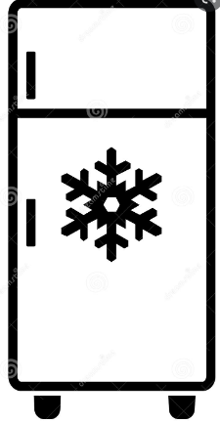
Proper Frozen Food Storage
Label and date (prevent freezer burn)
Rotate food (FIFO-first in-first out)
Prevent cross-contamination
Proper air circulation
Inspect and clean freezer frequently
Adequate lighting 10foot candles
Keep freezer away from wall and 6” off floor
Maintain temperature so that food remains frozen
Monitor temperature of freezer by placing a thermometer at or near door

Slide 35
Proper Dry Food Storage
Label food and date
Rotate stock (FIFO)
Unwrapped foods store in pest proof bins with tight fitting lids with proper label
Avoid cross contamination with allergen containing foods
Store shelving away from walls and 6” off floor
Adequate lighting 10foot candles
Monitor area for pest activity
Proper and immediate clean up of spills
Proper air temperature range of 50-70F; relative humidity 50-60%

Slide 36
Proper Chemical Storage
Store
Store supplies and chemical away from food, dishes, utensils, linens and single use items.
Store
Store all items off floor at least 6”
Keep
Keep cleaning supplies in original container
Label
Label all chemicals
Keep
Keep SDS sheets for all chemicals

Slide 37
Unit 3- Review
TCS food stored at 41F or less can be held for up to 7 days. TRUE or FALSE
Food must be stored off the floor in dry stock areas at least 12”. TRUE or FALSE
Refrigerators must have at least 10foot candles of light. TRUE or FALSE
Thermometer must be placed a warmest part of refrigerator near or at the door. TRUE or FALSE
Chemicals must be stored in original container. TRUE or FALSE

Slide 38
Unit Review Answers
TCS food stored at 41F or less can be held for up to 7 days. TRUE
Food must be stored off the floor in dry stock areas at least 12”. FALSE
Refrigerators must have at least 10foot candles of light. TRUE
Thermometer must be placed a warmest part of refrigerator near or at the door. TRUE
Chemicals must be stored in original container. TRUE

Slide 39
UNIT FOUR-Preparation and Cooking

Slide 40
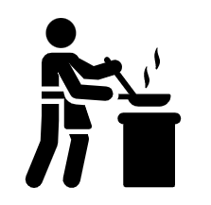
Cooking
Cooking time and temperature combinations are designed to reduce pathogens in food to a safe level.
Reduction of pathogens to safe levels requires knowing, cooking, measuring, monitoring and recording the correct minimum internal temperatures and times of food.

Slide 41
Cooking Rate Factors
Initial Temperature of the food
Food bulk
Airflow and hot spots in oven
Food composition
Facts acts like an insulator and increases cooking time
Moisture decreases cooking time
Char flame acts as an insulator increasing cooking time

Slide 42
Thawing Frozen Food
Freezing does not destroy pathogens but stops the growth.
Approved thawing methods
Refrigeration
Microwave
Running water at 70F or less
As part of cooking process

Slide 43
Minimum Proper Cooking Temperatures

Slide 44
Microwave Cooking
Food must be cooked to a minimum internal temperature of 165F.
The food must be covered to retain moisture and stirred/rotated during the cooking process.
The food must remain covered and allow to sit for 2 minutes before it is served.

Slide 45
Reheating Food
When reheating food:
Protect food from contamination
Food must reach internal temperature of 165F.
Dispose of reheated food if it does not reach 165F within 2 hours
Discard uneaten portions of reheated food.
Ready to eat food(packaged or canned) can be reheated to 135F.
Food that is for immediate service to consumer can be served at any temperature.

Slide 46
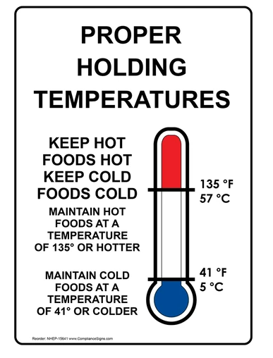
Holding Food
Hot Holding
Food must be hot held at 135F or above until served to consumer.
Cold Holding
Food must be cold held at 41F or less until served to consumer.

Slide 47
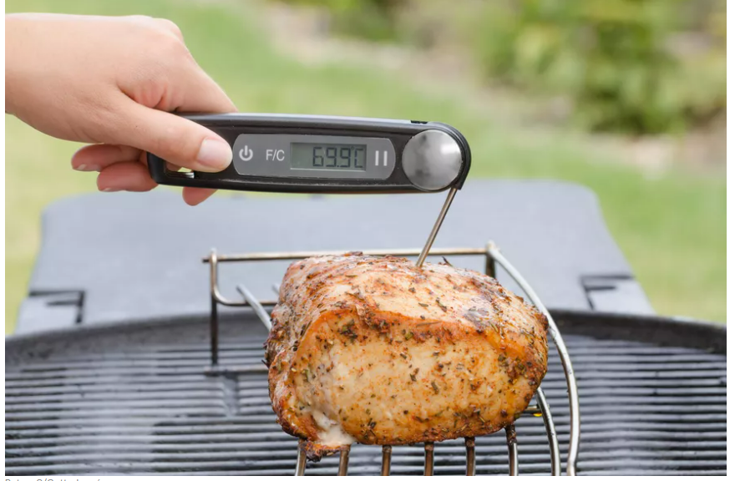
Checking Food Temperatures
A thermometer is the best method for checking food temperatures.
Follow the thermometer manufacturers instruction
Measure the core temperature of TCS food.
Insert clean, sanitized probe thermometer into the center of thickest part of food
Stir liquid food before measuring the ensure even temperature.
Thermometers must be calibrated daily or when dropped to ensure accuracy.

Slide 48
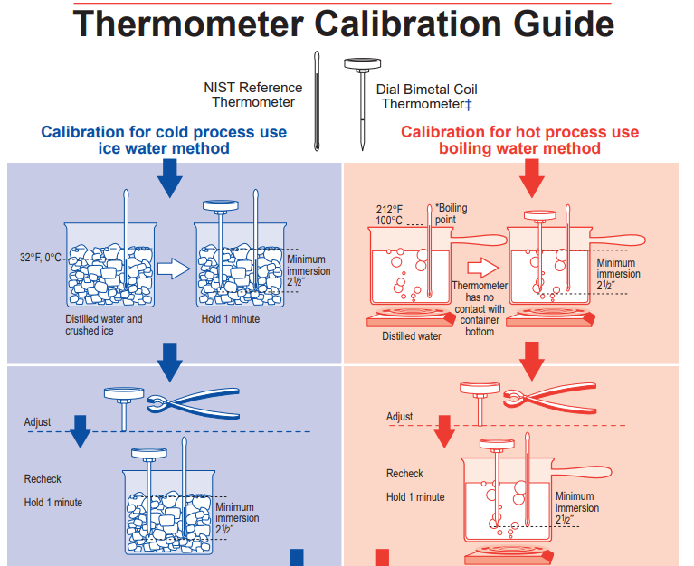
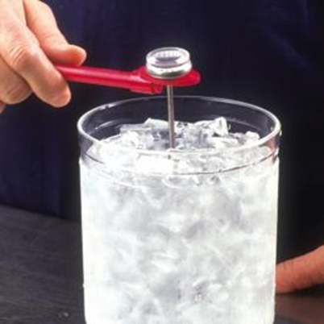
Ice Method
Boiling Point Method

Slide 49
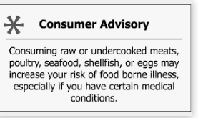
Consumer Advisory
The FDA Food Code requires a consumer advisory for any animal food such as beef, eggs, fish, lamb, milk, pork, poultry, or shellfish that is raw, undercooked or otherwise NOT processed to eliminate/reduce pathogens and is offered in a ready to eat form.
The consumer advisory is letting the consumer know there is a risk with uncooked/unprocessed foods in a ready to eat form.
The consumer advisory may be informed by brochures, menu, label statements, table tents, placards or other effective written communication.

Slide 50
Unit 4- Review
The minimum internal cooking temperature for poultry is 165F. TRUE or FALSE
A consumer advisory must be written only on the menu. TRUE or FALSE
There are 2 methods for calibrating food thermometers: Boiling Point and Ice Point. TRUE or FALSE
Hot food must be held at 145F until served to consumer. TRUE or FALSE
TCS food reheated must reach 165F before served to consumer. TRUE or FALSE

Slide 51
Unit Review Answers
The minimum internal cooking temperature for poultry is 165F. TRUE
A consumer advisory must be written only on the menu. FALSE
There are 2 methods for calibrating food thermometers: Boiling Point and Ice Point. TRUE
Hot food must be held at 145F until served to consumer. FALSE
TCS food reheated must reach 165F before served to consumer. TRUE

Slide 52
UNIT FIVE- Time and Temperature Control for Safety

Slide 53
Cooling
Cooling food is a risky food process due to spore forming bacteria.
Some bacteria can form spores that are resistant to heat and other unfavorable conditions.
Spore forming bacteria are capable of developing toxins include Bacillus cereus, Clostridium Perfringens, and Clostridium botulinum.
Proper cooling of food can prevent the growth of spore forming bacteria and toxin formation.
Spores cannot be killed by boiling, normal cooking, drying, freezing or most sanitizers.

Slide 54
Cooling
Properly cooled food can be stored at 41F or less for up to 7 days
Freezing stops the clock, the clock restarts when thawed.
If mixing older food with new food use the older date.
For example, chicken salad is made with cooked and cooled chicken on 7/21. The chicken salad is made on 7/23. The chicken salad will need to be date marked for discard on 7/27. You start counting 7 days from the initial chicken cook/cool 7/21 date.
Minimize leftovers, cook in small batches.

Slide 55
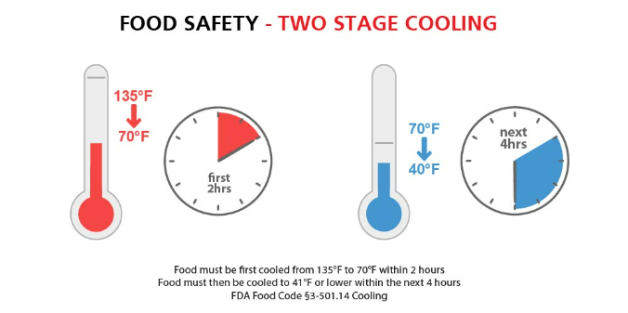
Proper Cooling Procedures- 2 stages

Slide 56
Cooling Factors
Depth heat must move/Size of container
Greater depth mean longer cooling time
Large containers- slower
Small shallow containers-faster
Ideally cooling food should be at 2” depth in container
Liquid versus Solids
Cooling method
Liquids(broths)- fast
Semi- liquid(chili)- slow
Solids(whole roast)-slowest
Loosely cover containers during cooling process
Stirring increase cooling rate
Quicker cooling, the safer the food

Slide 57
Time as Public Health Control
You can control the growth of bacteria through 2 ways:
TIME
Temperature.
Some food is difficult to keep hot or cold (Pizza).
TCS food can remain without temperature control for up to 4 hours.
Must have written procedures in advance
Label food with start time
Start temperature of food must be 135F or 41F
Discard after 4 hours
Cannot reheat or re-cool food item
If food is monitored and does not exceed 70F, food can be held for 6 hours.

Slide 58
Specialized Processes
Some food processes are super risky. These processes require plans in place to control the hazards.
Regulatory Agency approval will be needed for these processes.
Special Processed foods include:
Curing food
Smoking food for preservation
Reduced Oxygen Packaging
Custom Processing Animals
Acidification
Operating a Shellfish Tank

Slide 59
Unit 5- Review
Food can remain without temperature control for 7 hours. TRUE or FALSE
Liquids cool faster than solids. TRUE or FALSE
The ideal container to cool food is 4-5” in depth. TRUE or FALSE
Acidification is a specialized process. TRUE or FALSE
Properly cooled food can be stored in the refrigerator for up to 7 days. TRUE or FALSE

Slide 60
Unit Review Answers
Food can remain without temperature control for 7 hours. FALSE
Liquids cool faster than solids. TRUE
The ideal container to cool food is 4-5” in depth. FALSE
Acidification is a specialized process. TRUE
Properly cooled food can be stored in the refrigerator for up to 7 days. TRUE

Slide 61
UNIT SIX-Personal Hygiene and Reportable Illnesses

Slide 62
Personal Hygiene
An essential step in preventing foodborne Illness is good personal hygiene. Pathogens can be transferred from your skin or clothing to food or food contact surfaces.
Wear a clean hat or hair restraint
Wear clean outer clothing
Remove apron when you leave kitchen

Slide 63
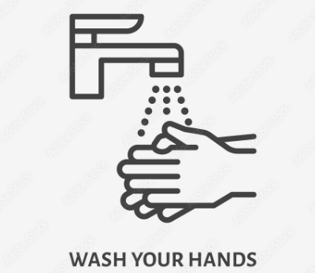
Personal Hygiene- HANDS
Hands, like gloves and dirty clothes, can contaminate food.
Hands
Keep fingernails clean and cut short
Do not wear nail polish
Do not wear fake nails
Cover cuts and sores with bandage and glove.
Wash hands, wash hands, wash hands

Slide 64
Proper Handwashing
Always use a hand sink- do not use dish or prep sink
Hand sink must have adequate flow of 100F water
Wet hands, wrists, arms warm water and soap
Rub soap for 10-15 seconds
Rinse
Dry with paper towel
Turn water off with paper towel
Hand sanitizers do not replace effective and proper handwashing

Slide 65
Handwashing sink Requirements
Adequate flow of 100F water
Soap
Paper towel
Trash can
Handwashing reminder sign

Slide 66
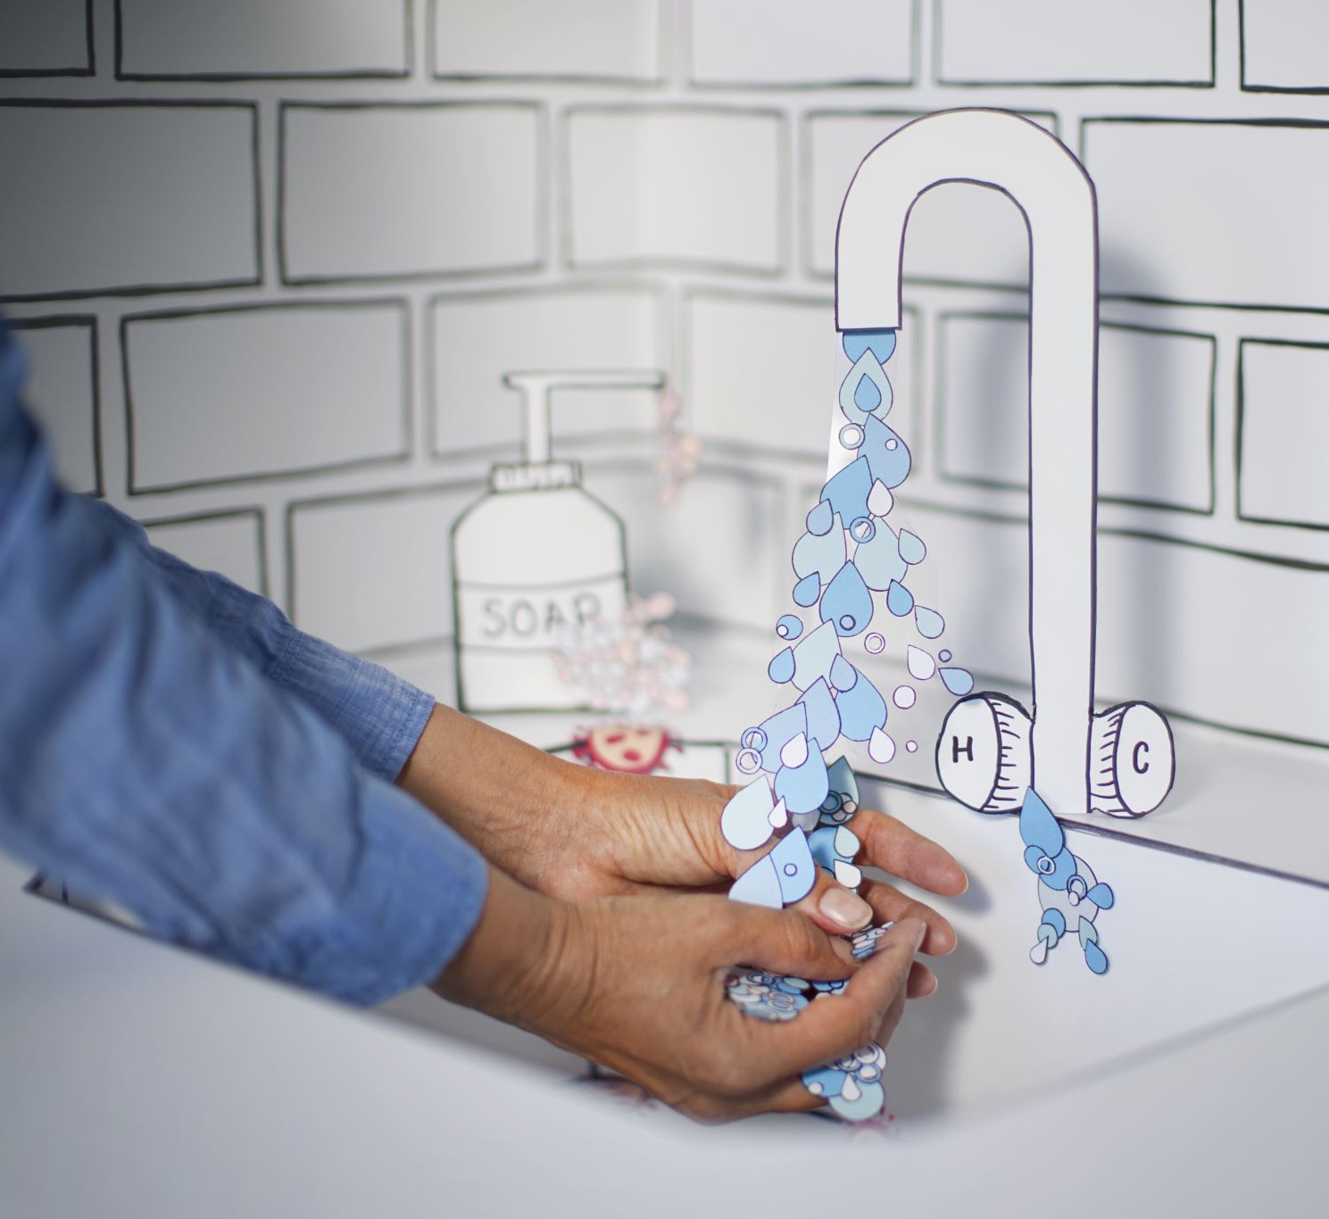
When to Wash Hands
Before-
Starting work
Touching raw food
Touching RTE food
Putting on gloves
During-
Food prep often
Switching between raw and cooked food
Switching between raw and RTE food
After-
Handling raw food
Using bathroom
Coughing, sneezing, blowing nose
Touching body
Cleaning
Changing gloves
Taking a break
Touching money
Any activity that may contaminate hands

Slide 67
Reporting Illness
Sick staff can contaminate food and spread illness in the kitchen and to others.
Do not allow sick staff to work while ill.
Follow the food establishments Employee Health Policy.
Follow the food establishments written plans for clean of vomit and diarrhea.

Slide 68
Employee Health Policy
If you need a copy of this poster, contact your assigned inspector

Slide 69
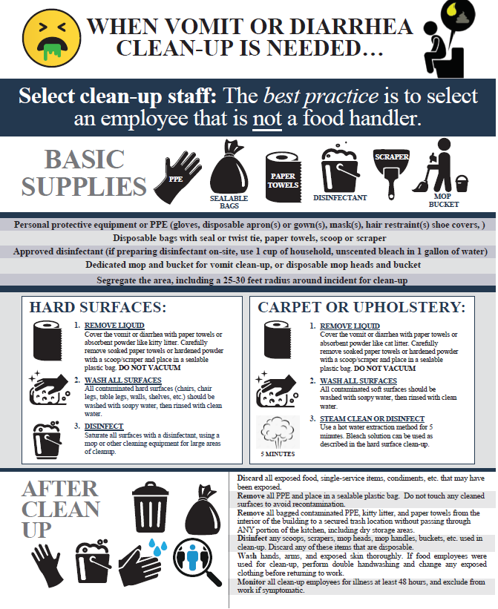
Clean up of Vomit and Diarrhea Plan
If you need a copy of this plan, contact your assigned inspector

Slide 70
Unit 6- Review
Hands can be washed at a food prep sink if soap and towels are available. TRUE or FALSE
The entire handwashing process should take 40 seconds. TRUE or FALSE
You can use hand sanitizer to replace handwashing. TRUE or FALSE
Hands must be washed after handling money. TRUE or FALSE
Food handlers should follow the food establishments Employee Health Policy. TRUE or FALSE

Slide 71
Unit Review Answers
Hands can be washed at a food prep sink if soap and towels are available. FALSE
The entire handwashing process should take 40 seconds. FALSE
You can use hand sanitizer to replace handwashing. FALSE
Hands must be washed after handling money. TRUE
Food handlers should follow the food establishments Employee Health Policy. TRUE

Slide 72
UNIT SEVEN- Cleaning and Sanitizing

Slide 73
Cleaning and Sanitizing
Cleaning is the process of removing soil from surfaces of equipment and utensils
Sanitizing is the process of reducing the number of pathogens on equipment and utensils to acceptable levels.

Slide 74
Cleaning and Sanitizing
Why?
Reduce the risk of biological contamination
Remove food, reducing bacteria on a surface
Protect food from contamination
Avoid attracting pests
Maintain safe environment

Slide 76
Cleaning and Sanitizing
What to clean?
All surfaces*
Handles, Doors, Shelving
Switches
Trash bins
What to sanitize?
All food-contact surfaces
Cutting board
Prep tables
Utensils
Slicers, Mixers, Knives, Tongs
Containers
Service items
*All surfaces can be cleaned and sanitized

Slide 77
Cleaning and Sanitizing
When?
All food contact surfaces should be cleaned and sanitized frequently.
FDA Food Code requires every 4 hours when used at room temperature.
Clean and sanitize
Before using equipment or utensils
Before switching to another type of food
As often as possible(every 4 hours of constant use)
End of shift
Anytime a risk of contamination

Slide 78
Cleaning and Sanitizing
How cleaning and sanitizing can be done:
Manual
Use of 3 compartment dish sink
Mechanical
Using of a dishwashing machine
Cleaning of fixed equipment
Manual and clean in place procedures

Slide 79
Manual Dishwashing Method
Pre-flush and pre-scrape
Wash at 110F
Rinse
Sanitize
Air dry

Slide 80
How to Sanitize
Chemicals
Quaternary Ammonium
100-200ppm with 75-120F water- contact time 30 seconds
Chlorine
50-100ppm depending on pH- contact time 10 seconds
Iodine
Heat
Hot water
Surface temperature must reach 160F
3 compartment sink- water temperature must be 171F+
Dishwashing machine-water temperature must be 180F+

Slide 81
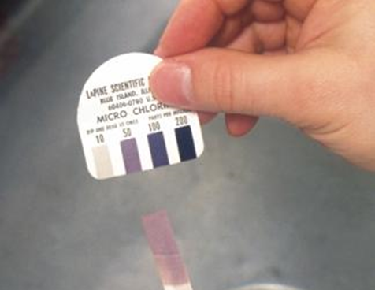
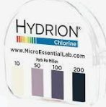
Cleaning and Sanitizing- Test Strips
Always follow manufacturer instructions and monitor concentration of sanitize with test strips.
Quat
Chlorine

Slide 82
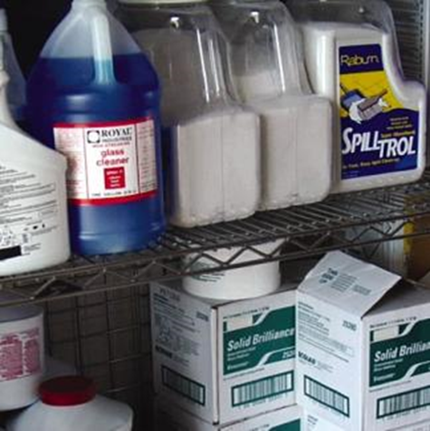
Chemical Safety
Store chemicals away from food areas
1
Keep chemicals in original bottle with label
2
Never mix chemicals together
3
Follow instructions on chemical label
4
Use PPE(gloves, aprons, eye protection) when cleaning
5
Wash hands after cleaning
6
Safety Data Sheets provide important information for all chemicals used at the food establishment. Keep Safety Data Sheets for reference.

Slide 83
Unit 7- Review
Surfaces must be sanitized before they can be cleaned. TRUE or FALSE
Cleaning reduces the numbers of pathogens to a safe level. TRUE or FALSE
Safety Data Sheets contain information about how to clean and sanitize. TRUE or FALSE
A slicer must be cleaned and sanitized. TRUE or FALSE
A test strip must be used for checking sanitizer strength. TRUE or FALSE

Slide 84
Unit Review Answers
Surfaces must be sanitized before they can be cleaned. FALSE
Cleaning reduces the numbers of pathogens to a safe level. FALSE
Safety Data Sheets contain information about how to clean and sanitize. FALSE
A slicer must be cleaned and sanitized. TRUE
A test strip must be used for checking sanitizer strength. TRUE

Slide 85
UNIT EIGHT-Integrated Pest Managment

Slide 86
Pest Management
Pests such as insects and rodents can contaminate food as well as damage the building.
Common pests:
Insects
Hide in cracks often move to boxes and bags
Carry pathogens
Birds
Contaminate via droppings
Pets
Can be a source of contamination(only service animals allow in inside dining area)
Rodents
A sign of poor sanitation
Can carry disease

Slide 87
Pest Management
Prevent pests by limiting access to:
FOOD
Clean daily
SHELTER
Reduce harborage areas by organizing storage, keeping items/equipment away from walls and off the floor
ACCESS
Limit access by sealing cracks and keep tightly sealed doors

Slide 88
Pest Management
FDA FOOD CODE Standards for controlling pests:
Premises maintained
Pest proof building
Routinely inspect incoming deliveries/supplies for pests
Use pest control methods
Eliminate harborage conditions(places pests can breed and hide)

Slide 89
Pest Management
Dry Storage areas:
Maintain door that close tightly
Repair cracks or holes in building
Monitor deliveries for pests
Remove from boxes and take boxes out immediately
Date and use FIFO food rotation
Store food in tightly sealed bins
Store food shelving away from walls and off floor at least 6”

Slide 90
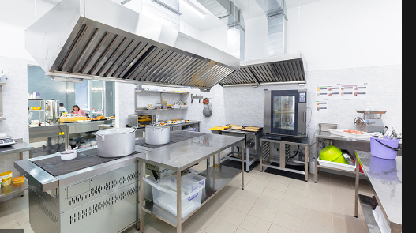
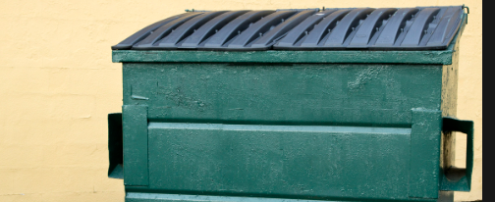
Pest Management
Kitchen
Leave all equipment clean and dry
Clean up, remove food debris and garbage daily
Clean floor drains daily
Clean tables, chair and floors
Remove all trash and garbage daily
Trash and Recycling
Maintain recycle bins- clean and good condition
Use liners and tight-fitting lids
Empty frequently and at least daily
Wash and dry bins regularly
Keep dumpster lids closed, have drain plugs, keep on concrete pad
Keep trash area 15 feet away from kitchen

Slide 91
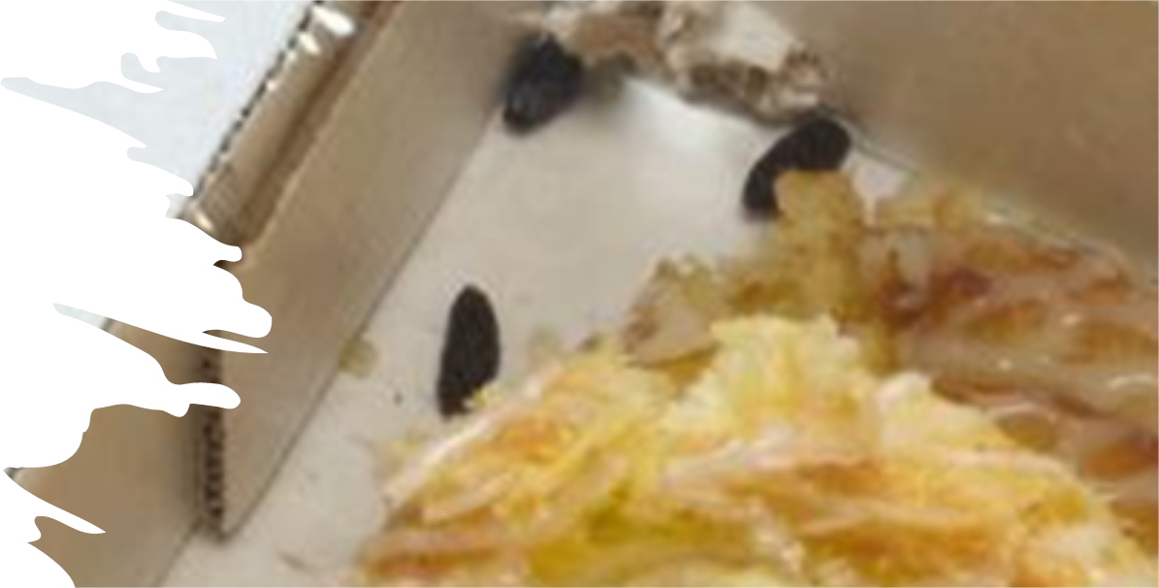
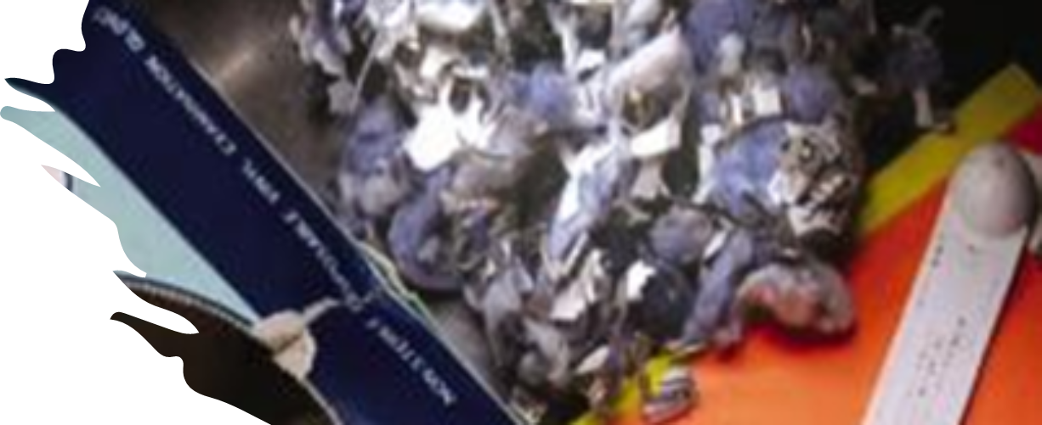
Pest Management
Conduct routine inspections of building for signs of pests
Identify pest harborages
Monitor deliveries
Look for dropping, gnaw marks and trails
Communicate with your Pest Control Operator
Keep a record of pest sightings
Explain attempts to at control measures
Show location of any baits/traps.
Accompany PCO during the visit to learn more about where pest hide.

Slide 92
Unit 8- Review
Food establishment buildings should be pest proof. TRUE or FALSE
Pests need FOOD, SHELTER and _____ to thrive.
Tight-fitting lids should not be used for food. TRUE or FALSE
Remove boxes from dry stock room immediately. TRUE or FALSE
Trash areas should away from the kitchen at least 20 feet. TRUE or FALSE

Slide 93
Unit Review Answers
Food establishment buildings should be pest proof. TRUE
Pests need FOOD, SHELTER and ACCESS to thrive.
Tight-fitting lids should not be used for food. TRUE or FALSE
Remove boxes from dry stock room immediately. TRUE
Trash areas should away from the kitchen at least 20 feet. FALSE

Slide 94
End of Training Review

Slide 95
Q1

Slide 96
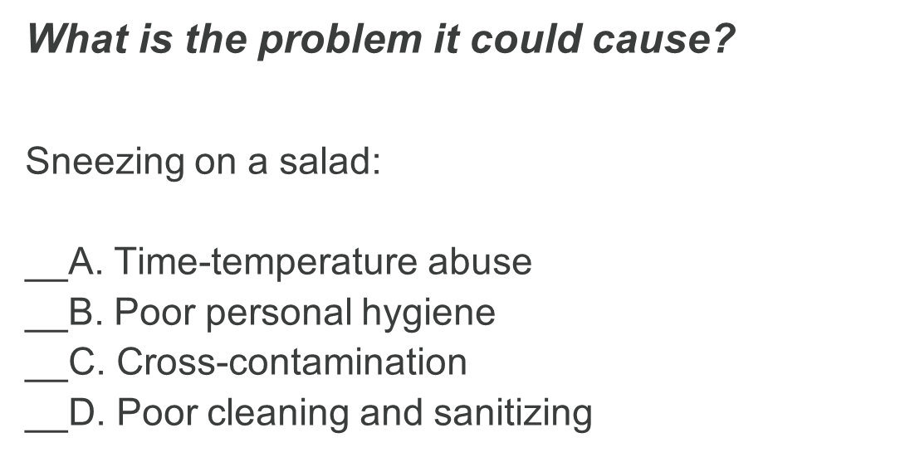
Q2

Slide 97
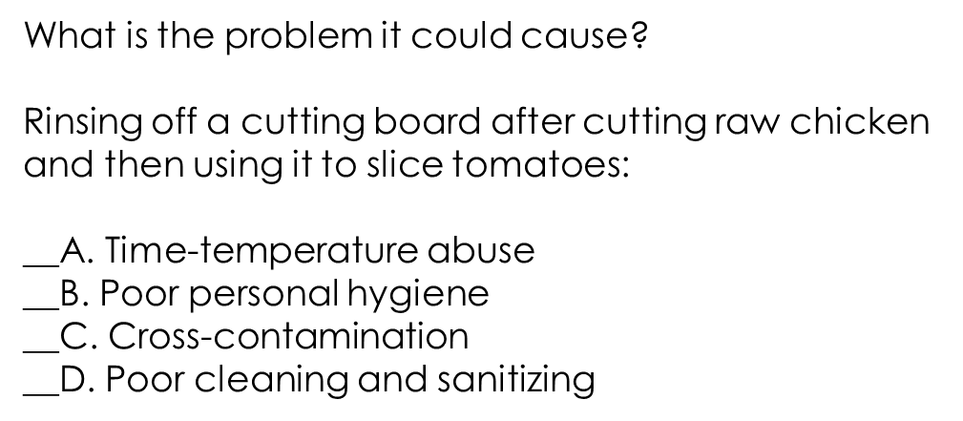
Q3

Slide 98
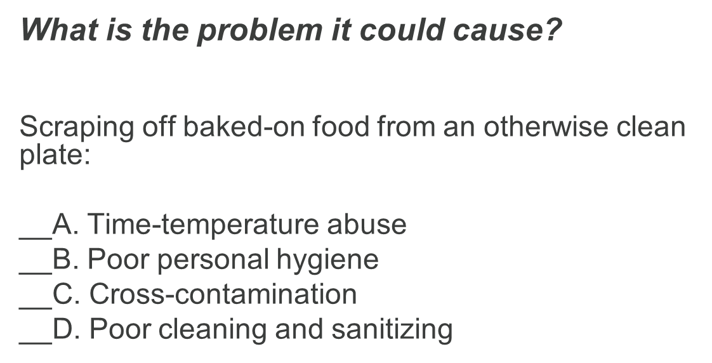
Q4

Slide 99
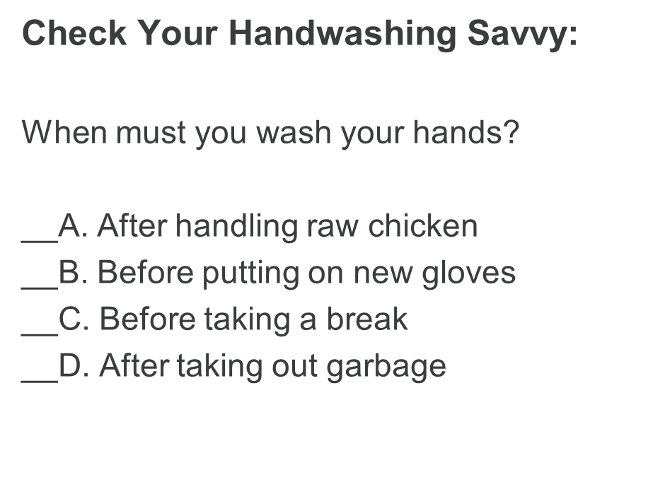
Q5

Slide 100
Q6

Slide 101
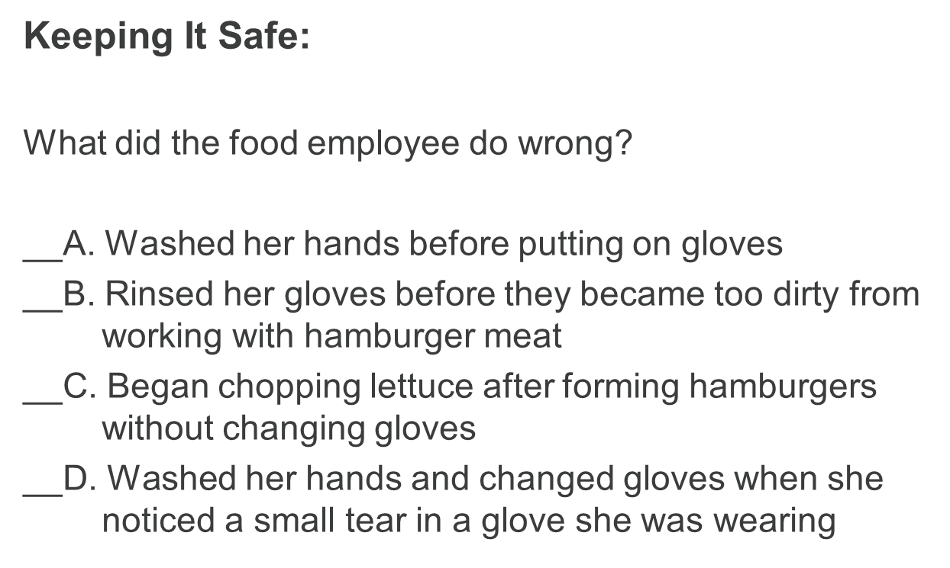
Q7

Slide 102
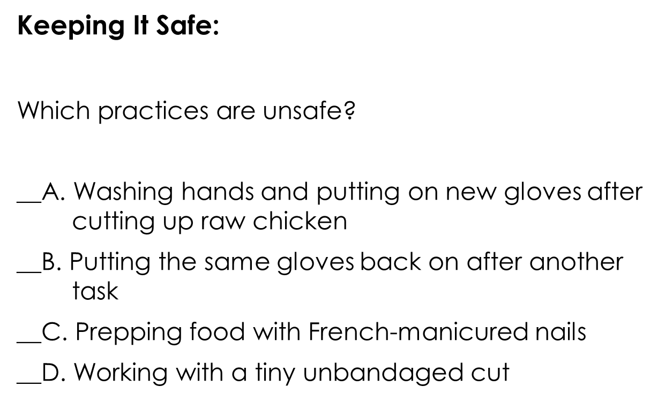
Q8

Slide 103
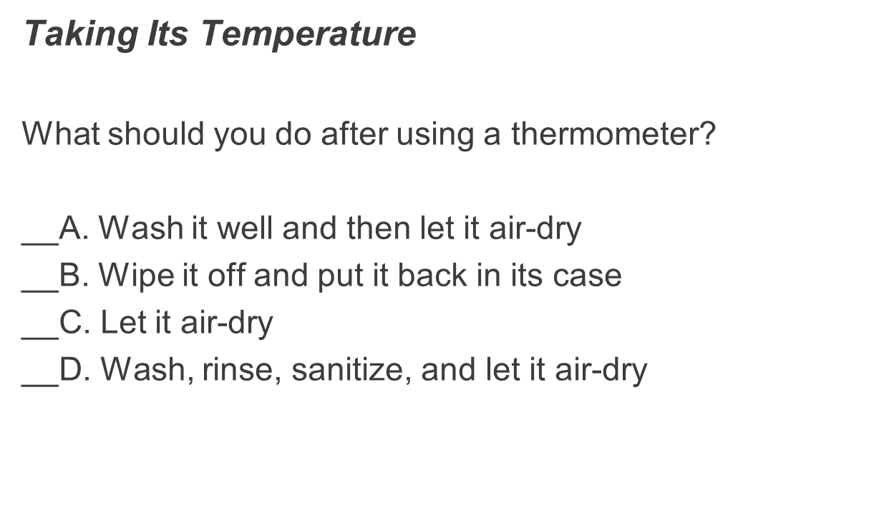
Q9

Slide 104
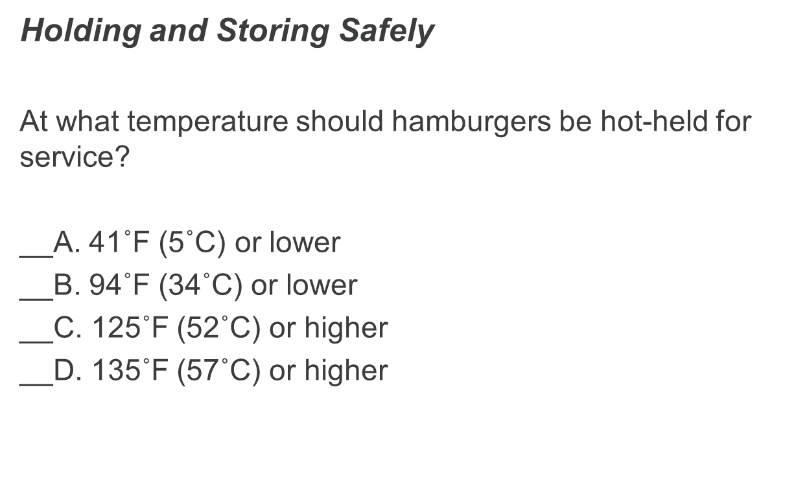
Q10

Slide 105
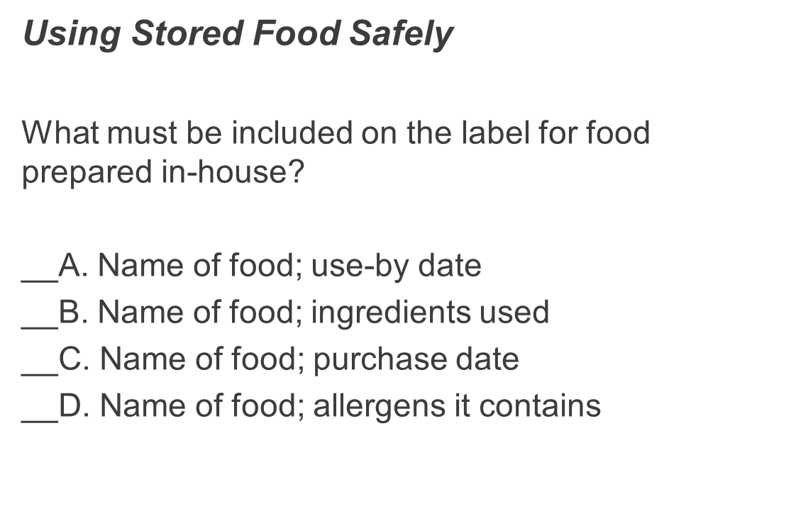
Q11

Slide 106
Q12

Slide 107
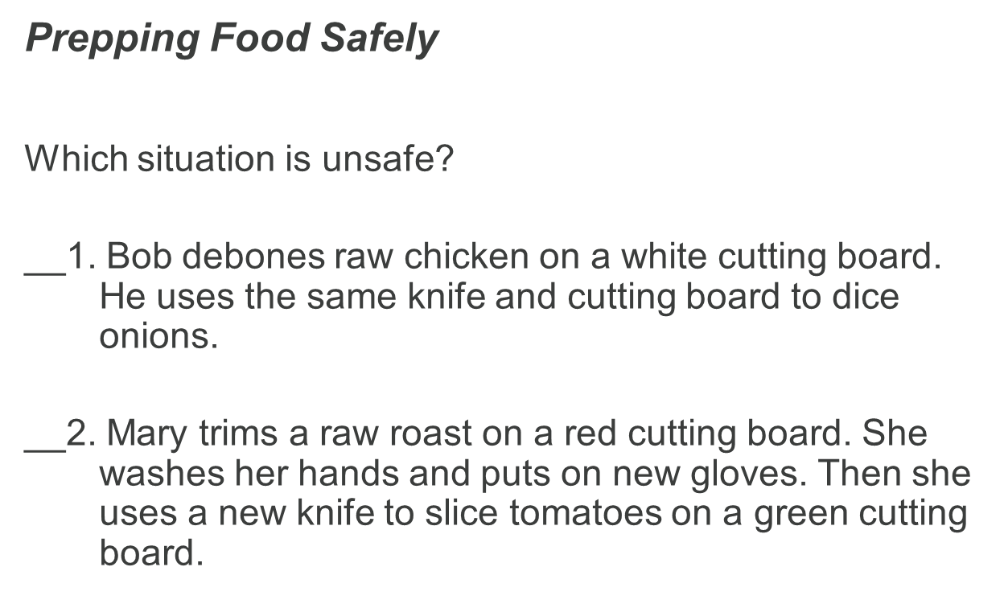
Q13

Slide 108
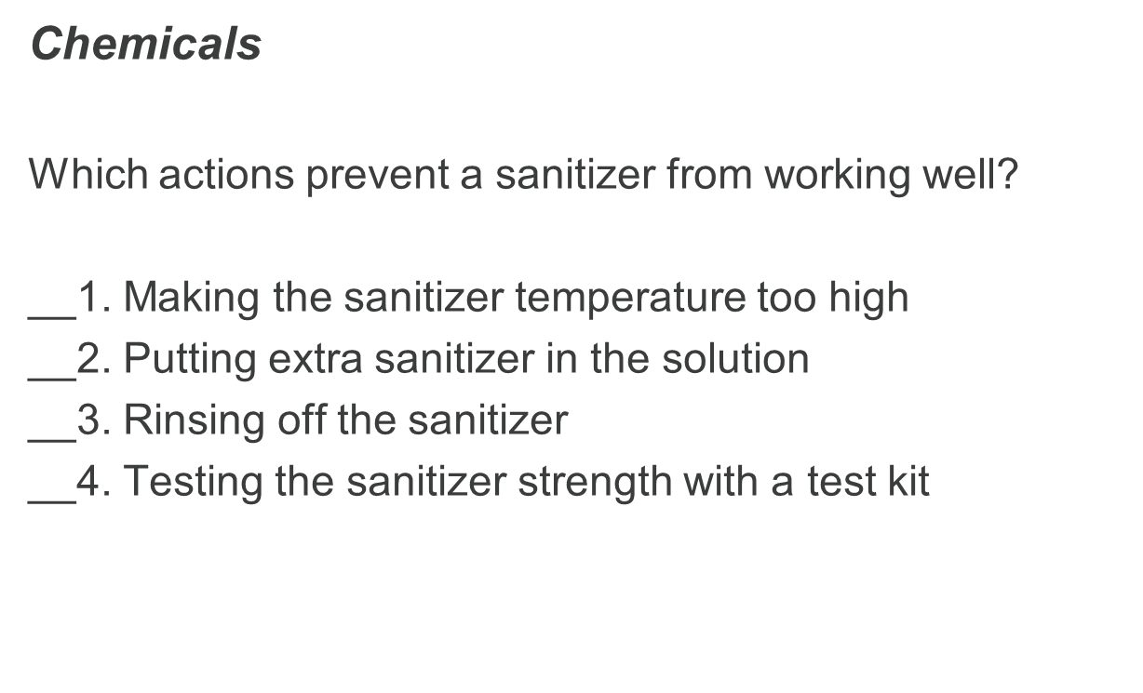
Q14

Slide 109
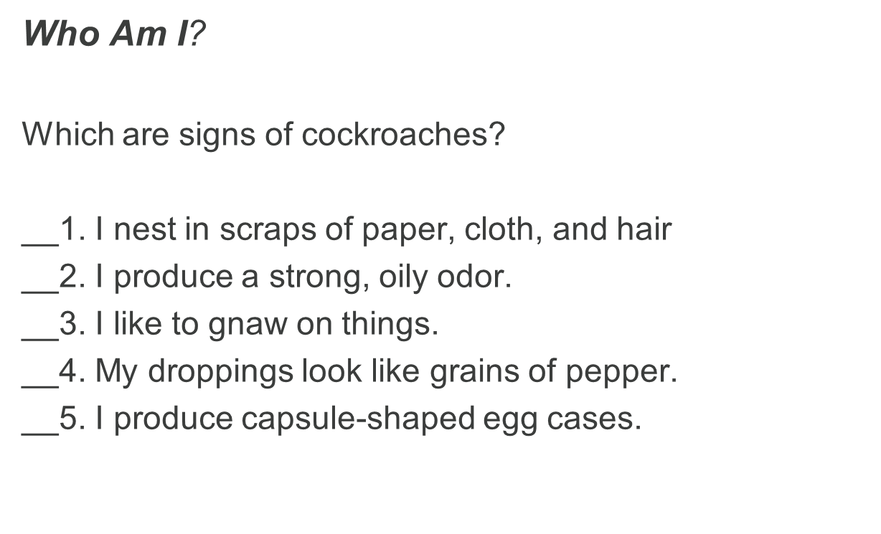
Q15

Slide 110
End of Training Review Answers
Q1- A
Q2-B
Q3-C
Q4-D
Q5-A,B,D
Q6-B, C, E, F
Q7-B, C
Q8-B, C, D
Q9-D
Q10-D
Q11-A
Q12-2,5,6
Q13-1
Q14-1,2,3
Q15-2,4,5

