Slide 1
Qualifications
Compensation
Precinct Election Official’s
Cannot be an elected government official, precinct chair, manager, or treasurer for any candidate or political party.
Must be a registered voter in Chatham County.
Must be able to read and write.
Must be computer literate.
Must be able to lift up to 40lbs
Must be able to perform all tasks that are required.
All precinct officials are expected to attend training, assist with setup the day before an election, and work on election day.
Chief Judges – Can earn up to $365
Judges – Can earn up to $285
Assistants – Can earn up to $260
Training
Training is mandatory to become a precinct official. The training is conducting by the Board of Elections.
Training is held in a classroom setting at Chatham County Board of Elections
Chatham County Board of Elections
984 Thompson Street Suite D
P.O Box111
Pittsboro, NC 27312
If you have any more questions, please feel free to call us or visit our website for more information.
919-545-8500
www.chathamnc.org/BOE
919-545-8500
www.chathamnc.org/BOE
Elections

Slide 2
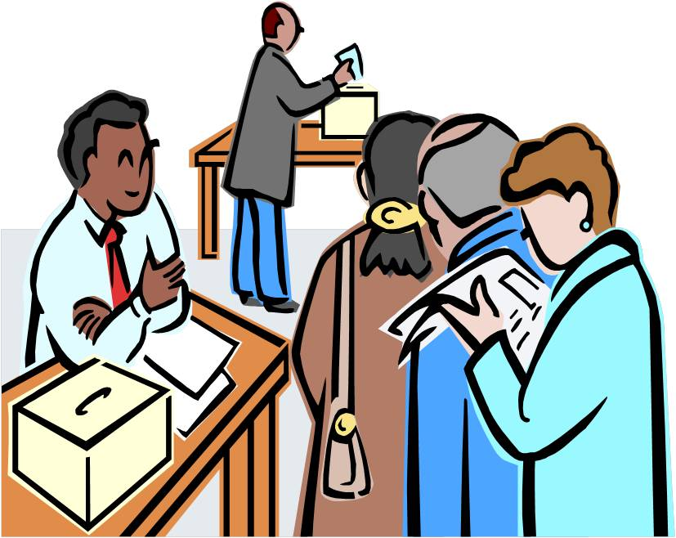
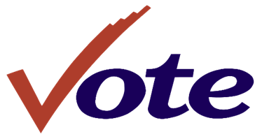
Chief Judges
Election Assistants
Judges
What is a Chief Judge?
What is an Elections Assistant?
What is a Judge?
They’re the head official at the precinct site.
They’re responsible for the proper setup of the election site.
They’re in charge of returning election day supplies to the BOE from the Precinct site on election night.
Chief Judge positions are appointed by the two largest parties in the county.
Election assistants are selected by the Board of Elections Staff.
Election Assistants check in registered voters. And process curbside voters.
Provide voters with correct ballots and direct the voter to the voting unit.
Serve when needed and at the discretion and direction of the chief judge.
Judge's responsibilities include working closely with the chief judge.
There are two judges at each precinct with at least one member from the county's two largest parties.
Perform duties such as signing all official documents and assist the chief judge with resolving challenges.
How Appointed/Selected
The Board of Elections selects a list of recommend applicants to be submitted to the parties. If selected chief judges are appointed by the BOE and serve a two-term. The position begins in August of odd numbered years.
Elections

