Slide 1
OLD US 1 GENERAL USE NEIGHBORHOOD BUSINESS REZONING
Bradshaw Robinson Slawter & Rainer LLP
Applicant: Hardip Dhillon
January 17, 2023

Slide 2
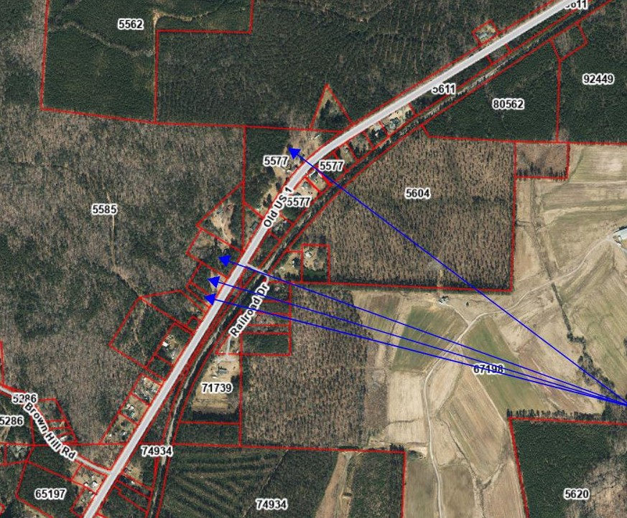
Subject Property: Parcels 5336, 5584, 84340, and a portion of 5577

Slide 3
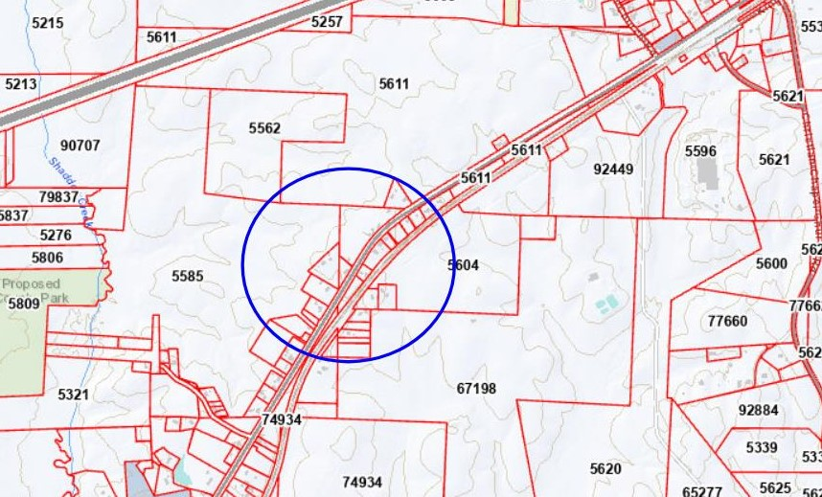

Slide 4
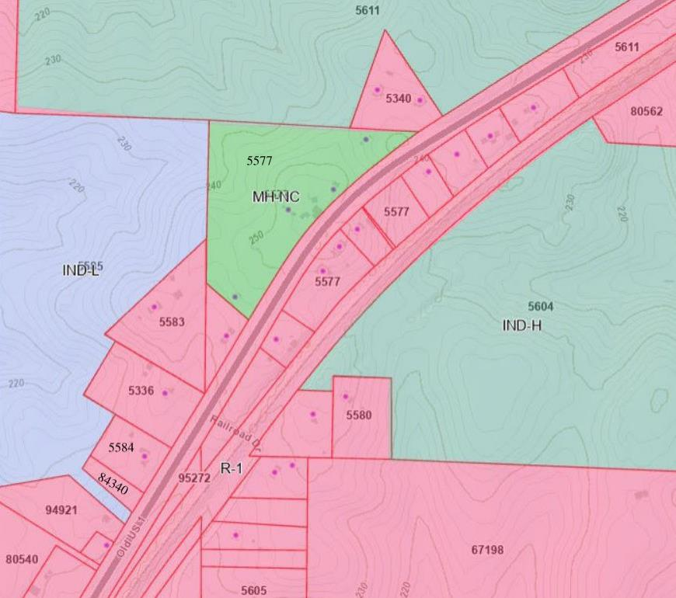
Current Zoning: Parcels 5336, 5584, and 84340 are R-1; the subject portion of Parcel 5577 is legacy MH-NC.

Slide 5
FINDING 1: ALLEGED ERROR IN ORDINANCE
The subject portion of Parcel 5577 on the north side of Old US 1 has a legacy MH-NC zoning district designation
The Applicant seeks to update the existing MH-NC zoning district designation of the northern portion of Parcel 5577 and the R-1 zoning designations of Parcels 5336, 5584 and 84340 to a Neighborhood Business zoning classification
Applicant believes Finding 1 is met.

Slide 6
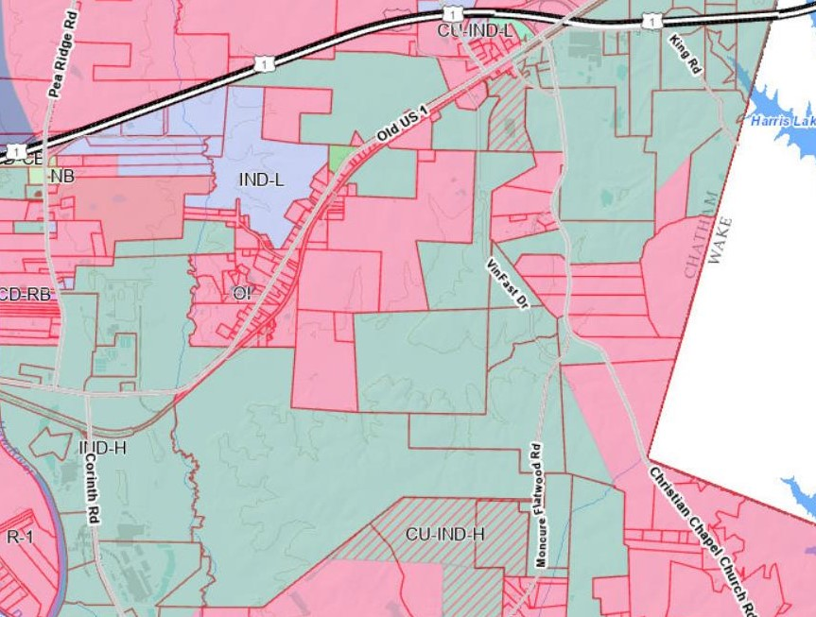
FINDING 2: CHANGED OR CHANGING CIRCUMSTANCES
Need and Desirability
Located a short distance from Midpoint Logistics Park (I-L) and the Moncure Megasite (I-H), the proposed rezoning will complement the upcoming developments off Old US 1
This area of the County is experiencing economic growth as part of the vision adopted by the Comprehensive Land Use Plan and leadership of this Board
This proposed Neighborhood Business zone acts a bridge between Residential and Industrial areas by connecting residents to a growing commercial center in the County
Provide needed services to both the residents and the employees
Reduce commuting times and consumption of energy

Slide 7
FINDING 2: CHANGED OR CHANGING CIRCUMSTANCES
Survey of Similar Uses
Since the adoption of the Comprehensive Land Use Plan, the Zoning Ordinance Map has adjusted according to the County’s changing demands and needs
Recently, Mad Pea Ridge, LLC, the owner of Parcels 5585 and 5807, succeeded in amending the Zoning Map from R-1 to I-L
Additionally, Parcels 5604 and 5611 are currently zoned for I-H
Earlier this evening, adjacent property owned by Because of His Grace, LLC (Parcels 77640, 80540, 94921, and 5588) was rezoned to Neighborhood Business
The proposed rezoning for Neighborhood Business will supplement the needs of residents living nearby as well as the employees who will work in the Industrial areas
There is very little, if any, nearby property properly zoned for retail and neighborhood-type business development

Slide 8
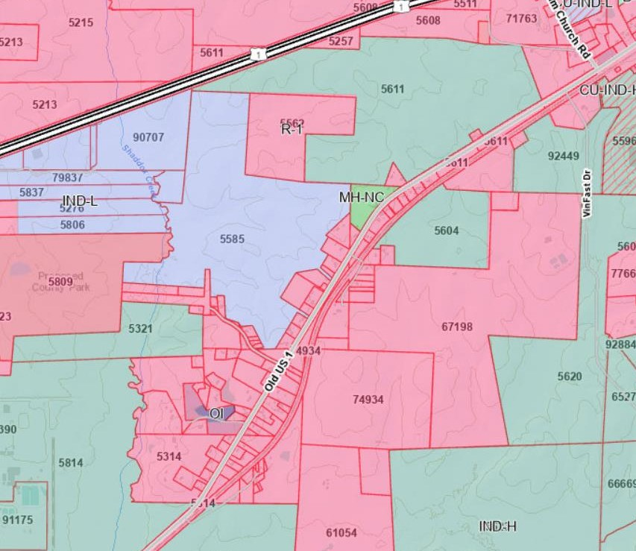
Nearby Zoning: I-L to the north and west, I-H all around, and Neighborhood Business to the south as of tonight.

Slide 9
FINDING 2: CHANGED OR CHANGING CONDITIONS
Public Provided Improvements
None needed
Tax Considerations
Diversify tax revenue for Chatham County by adding commercial property to the tax base, especially near the Moncure Megasite
Generate sales tax revenue from commerce
Employment
It is anticipated that businesses will flourish in this area in both the short and long-term due to the TIP projects and other pending rezonings, thereby creating ample employment opportunities consistent with the Comprehensive Plan objective for the nearby Employment Center
Applicant believes Finding 2 is met.

Slide 10
FINDING 3: COMPREHENSIVE LAND USE PLAN
This proposed rezoning is consistent with the goals and objectives of the Comprehensive Land Use Plan. The examples listed below highlight the consistency:
Chapter Two – Issues and Opportunities
Employment
The Comprehensive Plan identifies in-county employment as an area that needs attention (p. 16)
With the Moncure Megasite planning for 7,500 employees, supporting businesses and services will be necessary to accommodate the incoming workforce as well as the existing community
Rezoning to Neighborhood Business will also promote a diversified tax base, which is an opportunity to address the County’s reliance on the residential tax base (p. 20)
Another opportunity tied to both employment and taxes is reducing “retail leakage” (p. 16)
According to the Comprehensive Plan, 58% of potential retail sales are lost to other counties (p. 16)
By rezoning to Neighborhood Business, businesses that move into the area will have the opportunity to serve in-county retail needs

Slide 11
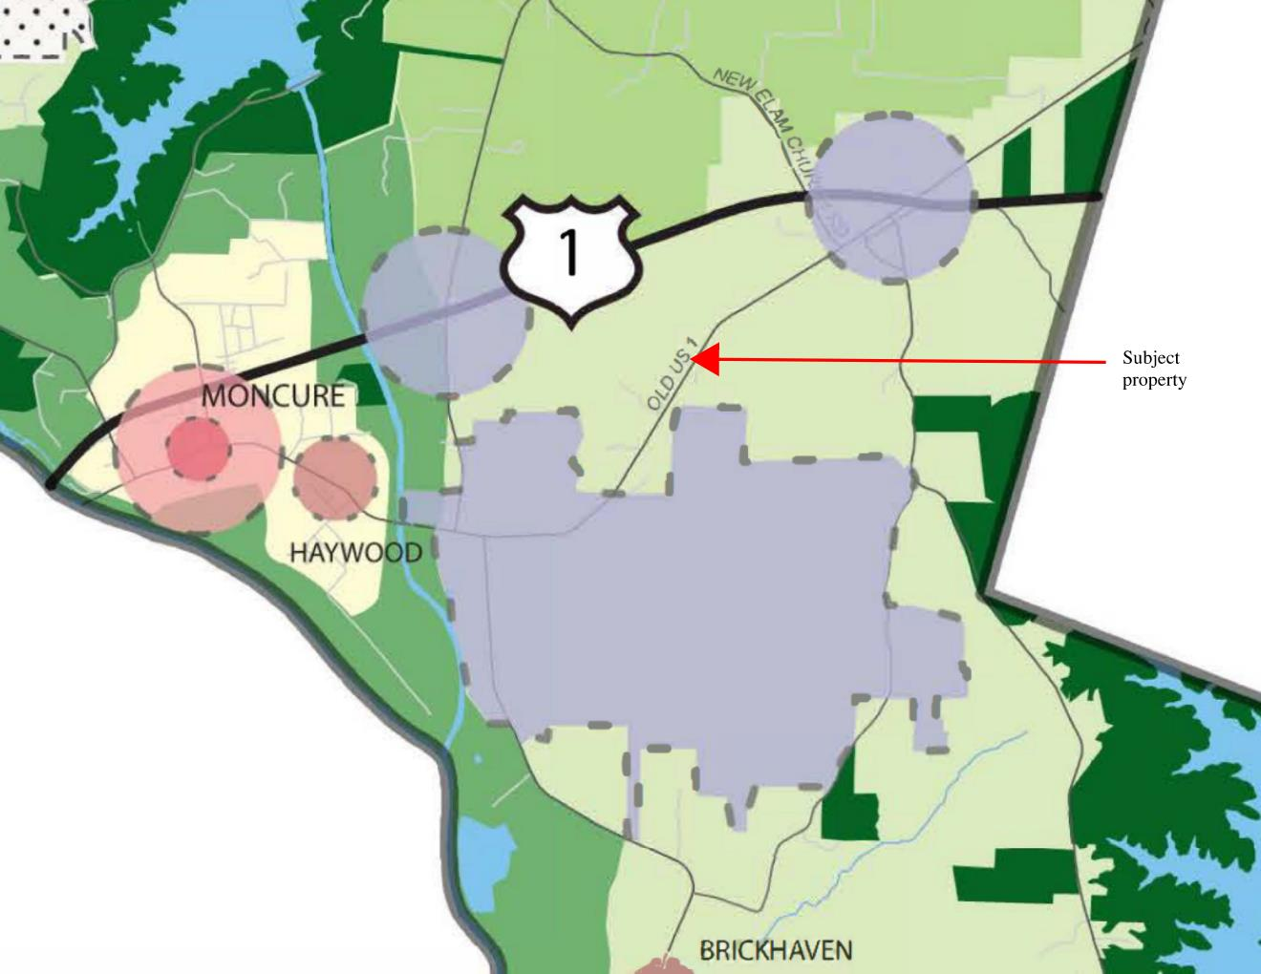
FINDING 3: COMPREHENSIVE LAND USE PLAN
Chapter Three – Goals and Objectives
Goal: diversify the tax base and generate high-quality, in-county jobs is served by rezoning the properties to Neighborhood Business given the location, demand, and needs of the County (p. 41-42)
Although the subject parcels are designated as Rural in the Future Land Use Map, many rezonings have diverged from their predicted use because the properties are in close proximity to the Moncure Megasite employment center and an employment center surrounding the interchanges at Pea Ridge Road and US 1
This Employment Center is growing and the subject parcels are well-suited to be included in this developing Employment Center

Slide 12
FINDING 3: COMPREHENSIVE LAND USE PLAN
Chapter Four – Economic Development
Goal: “diversify the tax base and generate more high-quality, in-county jobs to reduce dependence on residential property taxes, create economic opportunity, and reduce out-commuting” (p. 53)
Numerous ED Policies apply to the proposed rezoning:
Policy 2 “encourage[s] growth in designated Employment Centers, towns, and other appropriate locations” (p. 55)
Policy 3 supports the continued development of the Moncure Megasite and surrounding areas “to ensure future job creation in the County” (p. 55)
Policy 4 to “support existing businesses” also applies to rezoning the subject parcels (p. 56)
Policy 6 encourages the County to “support entrepreneurship and new businesses that diversify the local economy and capitalize on the unique assets of Chatham County” (p. 57)
Applicant believes Finding 3 is met.

Slide 13
FINDING 4: ESSENTIAL OR DESIRABLE FOR PUBLIC CONVENIENCE OR WELFARE
The proposed rezoning is essential or desirable because it will facilitate services to meet the needs being created by growth in this part of the County
Additional notes:
Traffic – no significant impact anticipated
Visual Impact – to be reviewed by the Appearance Commission as plans develop
Lighting – plans will satisfy requirements of the Zoning Ordinance
Noise – no significant impact anticipated
Chemicals, etc. – any chemical storage or use will satisfy applicable regulations
Signs – plans will satisfy the requirement of the Zoning Ordinance
Emergency Services – no significant imposition on fire, police, or 911 services are required
Impact to Surrounding Land Values – no negative impacts anticipated
Applicant believes Finding 4 is met.

Slide 14
FINDING 5: OTHER REASONS IN SUPPORT
The proposed rezoning is generally consistent with and needed to support the growth in Southeast Chatham County
Additional notes:
Water Source – Chatham County public water
Wastewater Management – sanitary sewer service will be designed and permitted by the appropriate agencies
Water/Sewer Impact – plans will satisfy requirements of the Zoning Ordinance
Access Roads – Old US 1
Stormwater Runoff – to be planned on-site as required by Chatham County Stormwater Ordinance and NC Dept. of Environmental Quality
Applicant believes Finding 5 is met.

Slide 15
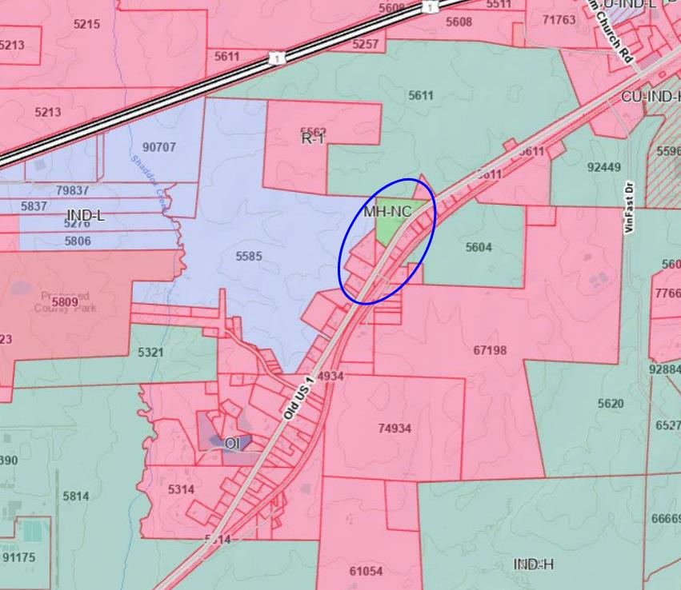
CONCLUSION
The Applicant has shown support for each of the Findings as required by the Zoning Ordinance.
In sum, the proposed rezoning to Neighborhood Business facilitates a variety of economic opportunities for Chatham County and its residents and complies with the Future Land Use Map.
While our initial presentation ends here, we would like to reserve a short amount of time to respond to any concerns that may be raised by members of the public later in this hearing.

