Slide 1
SKY MART GENERAL USE NEIGHBORHOOD BUSINESS REZONING
Bradshaw Robinson Slawter & Rainer LLP
Applicant: Hardip Dhillon
January 17, 2023

Slide 2
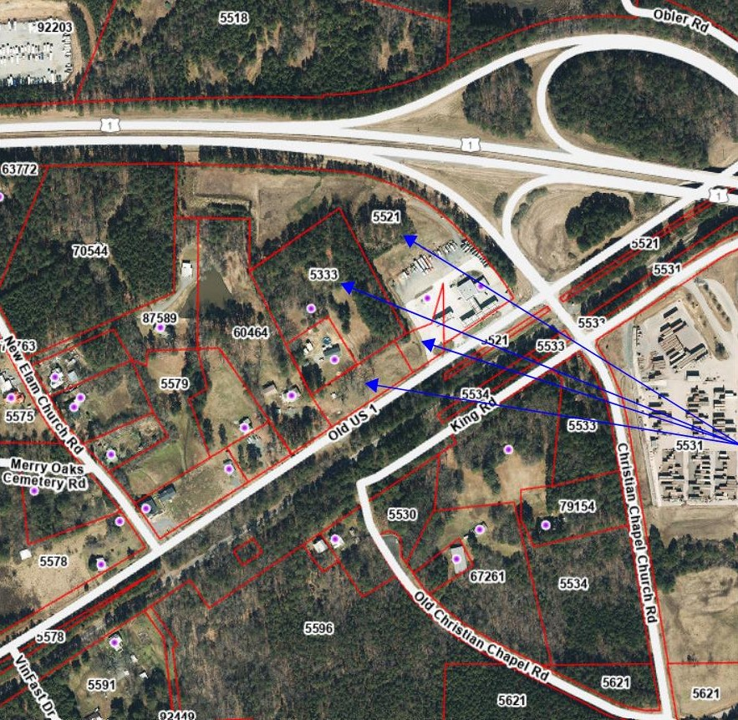
Subject Property:
Parcels 5333, 5517, 5520, and 5521

Slide 3
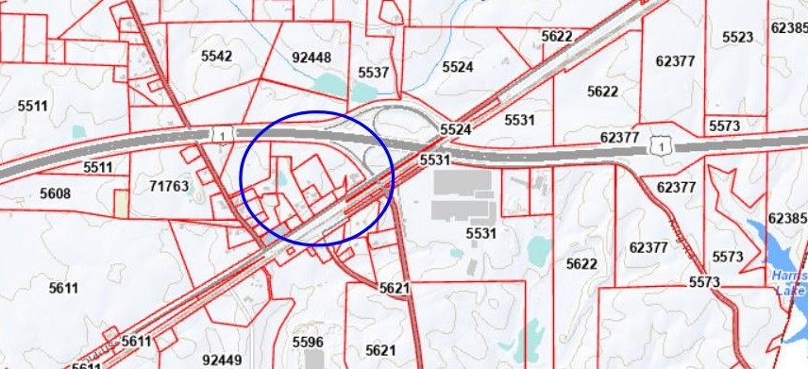

Slide 4
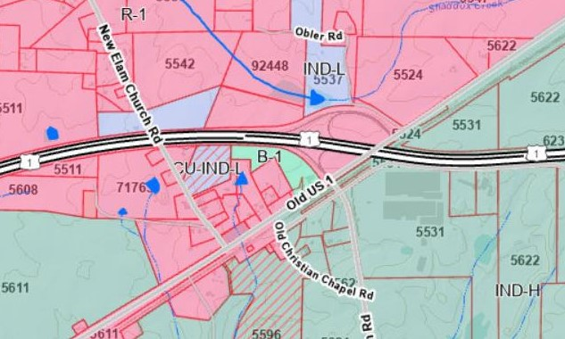
Current Zoning: Parcel 5521 and a portion of Parcel 5520 are legacy B-1 zoning. Parcels 5333, 5517, and the remainder of 5520 are R-1.

Slide 5
FINDING 1: ALLEGED ERROR IN ORDINANCE
Parcel 5521 and a portion of Parcel 5520 have a legacy B-1 zoning district designation
The Applicant seeks to update the existing old Zoning Ordinance B-1 designation to the current Zoning Ordinance zoning designation of Neighborhood Business
Additionally, the Applicant seeks to change the zoning map to revise the remaining parcels, currently zoned R-1, to Neighborhood Business as well
Applicant believes Finding 1 is met.

Slide 6
FINDING 2: CHANGED OR CHANGING CIRCUMSTANCES
Need and Desirability
NC DOT State Highway Project HE-0006 is proposed to take property from or impose easements upon portions of Parcels 5517, 5520, and 5521
Sky Mart convenience store, fueling stations, and parking areas will likely need to be reconstructed to accommodate the potential taking
In light these changing circumstances, all four of the Applicant parcels need to be rezoned to facilitate the anticipated reconstruction and to encourage potential employment opportunities as called for under the Comprehensive Plan

Slide 7
FINDING 2: CHANGED OR CHANGING CONDITIONS
Survey of Similar Uses
Given the existing mix of I-H to the south and west, I-L to the west and north, legacy B-1 to the north, this Neighborhood Business District will complete the necessary array of zoning designations for the Employment Center shown on the Future Land Use Map
Public Provided Improvements
None needed
Tax Considerations
Diversify tax revenue for Chatham County by adding commercial property to the tax base
Generate sales tax revenue from commerce
Employment
Creates the opportunity for a wide range including, but not limited to, food stores, dry cleaning, general offices, hotels, and ABC stores
Applicant believes Finding 2 is met.

Slide 8
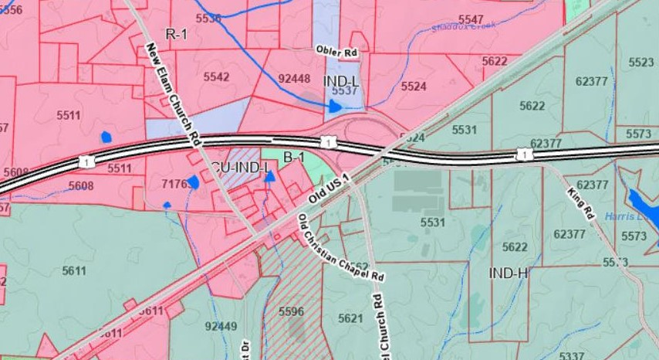
Nearby Zoning: I-H to the south and west, I-L to the west and north, legacy B-1 to the north.

Slide 9
FINDING 3: COMPREHENSIVE LAND USE PLAN
This proposed rezoning is very much consistent with the goals and objectives of the Comprehensive Land Use Plan. Highlighted below are a few examples of that consistency:
Chapter Two – Issues and Opportunities
Most of Chatham workers commute outside of the County for work (p. 16)
While Chatham residents are away at work, they are shopping, eating, and enjoying recreation outside of the County, which results in “retail leakage” (p. 16)
In addition, the commercial/industrial tax base, although changing recently, has historically been relatively low in Chatham County compared to surrounding counties (p. 20)
Rezoning to Neighborhood Business presents an opportunity to further address these key issues

Slide 10
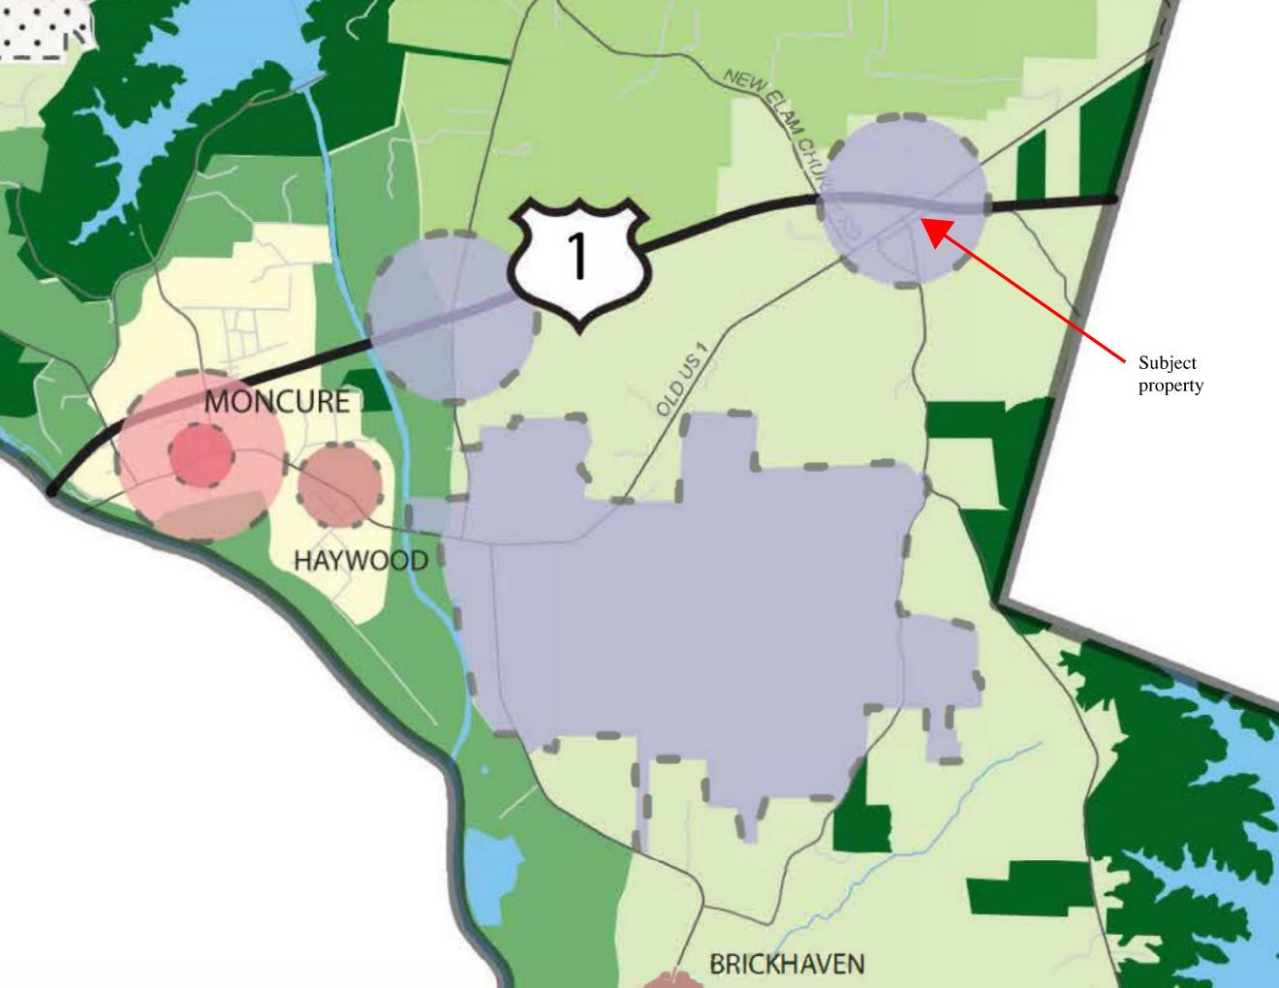
FINDING 3: COMPREHENSIVE LAND USE PLAN
Chapter Three – Goals and Objectives
Goal: “diversify the tax base and generate more high-quality, in-county jobs” (p. 40)
The return on investment for $1.00 worth of public services for commercial and industrial land use is notably higher at $3.01 compared to residential land use at $0.87 (p. 21)
The Future Land Use Map shows that the subject property is included within an area designated as an Employment Center (p. 47)
Generate high-quality jobs (p. 47)
Employment Centers should allow for “regional accessibility” which exists at this juncture of US Highway 1 and Old US 1
This proposed rezoning is entirely consistent with the Land Use Descriptions in the Comprehensive Plan and is located in the precise area designated by the Future Land Use Map

Slide 11
FINDING 3: COMPREHENSIVE LAND USE PLAN
Chapter Four – Economic Development
Goal: “diversify tax base and generate more high-quality, in-county jobs to reduce dependence on residential property taxes, create economic opportunity, and reduce out-commuting” (ED Recommendation 01, p. 54)
Goal: “increase employment opportunities across the County” (ED Recommendation 02, p. 54)
ED Policy 2: “encourage growth in designated Employment Centers, towns, and other appropriate locations” (p.55)
ED Strategies also support the development of small-scale retail, services, and restaurants (ED Strategies 2.1-2.2, p. 55)
Located between US Highway 1 and Old US 1, the rezoning creates the potential for hotels or other accommodations

Slide 12
FINDING 3: COMPREHENSIVE LAND USE PLAN
Chapter Four – Economic Development Cont.
Rezoning supports the existing business, Sky Mart, and encourages commercial development as a reasonable expansion of the area (ED Policy 4, ED Strategies 4.2 and 4.4, p. 56)
ED Recommendation 03 is to “support entrepreneurship, tourism, arts, and culture” (p. 57)
Based on the location of the proposed rezoned areas, there are opportunities for entrepreneurship and tourism (ED Policy 06, p. 57)
Applicant believes Finding 3 is met.

Slide 13
FINDING 4: Essential or Desirable for Public Convenience or Welfare
The proposed rezoning is essential or desirable because it will facilitate services to meet the needs being created by other growth in this part of the County
Additional notes:
Traffic – no significant impact anticipated
Visual Impact – to be reviewed by the Appearance Commission as plans develop
Lighting – plans will satisfy requirements of the Zoning Ordinance
Noise – no significant impact anticipated
Chemicals, etc. – petroleum products are present and accounted for at Sky Mart, other chemicals are not anticipated
Signs – plans will satisfy requirements of the Zoning Ordinance
Emergency Services – no significant imposition on fire, police, or 911 services are required
Impact to Surrounding Land Values – no negative impacts anticipated
Applicant believes Finding 4 is met.

Slide 14
FINDING 5: Other Reasons In Support
The proposed rezoning is generally consistent with and needed to support the impending growth in Southeast Chatham County
Additional notes:
Water Source – no expansion is necessary as the property is serviced by Chatham County public water
Wastewater Management – sanitary sewer service will be designed and permitted by the appropriate agencies
Water/Sewer Impact – plans will satisfy requirements of the Zoning Ordinance
Access Roads – Old US 1
Stormwater Runoff – to be planned on-site as required by Chatham County Stormwater Ordinance and NC Dept. of Environmental Quality
Applicant believes Finding 5 is met.

Slide 15
CONCLUSION
The Applicant has shown support for each of the Findings as required by the Zoning Ordinance.
In sum, the proposed rezoning to Neighborhood Business facilitates a variety of economic opportunities for Chatham County and its residents and complies with the Future Land Use Map.
So that concludes our initial presentation! We would like to reserve a short amount of time to respond to any concerns that may be raised by members of the public later in this hearing.

