Slide 1
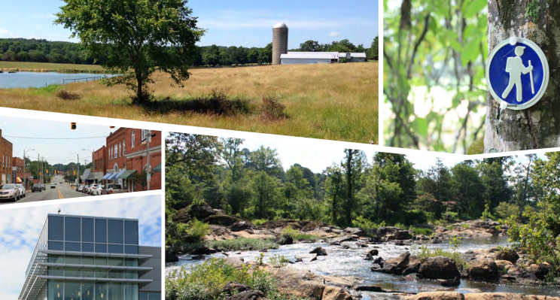
Hawk Point Road Extension First Plat
Planning Staff: Kimberly Tyson & Hunter Glenn
Applicants: Silver Developers, LLC
Request by Susan Joplin on behalf of Silver Developers, LLC for subdivision First Plat review and approval Hawk Point Road Extension, on 20.35 acres, located off Hawk Point Road, parcel 92282 and 95254.

Slide 2
Introduction and Background
Zoning: CUD-CC (parcel 92282) and R-1 (parcel 95254)
Water System: Public Water
Subject to 100 Year Flood: Special flood hazard area within the development
General Information: The subdivision process is a four (4) step process: Concept Plan, First Plat, Construction Plan, and Final Plat. The applicant has completed the community meeting and the Concept Plan review. The Planning Board has two (2) meetings in which to act on the proposal.
Sewer System: N/A

Slide 3
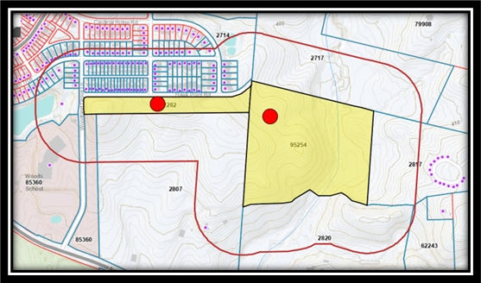
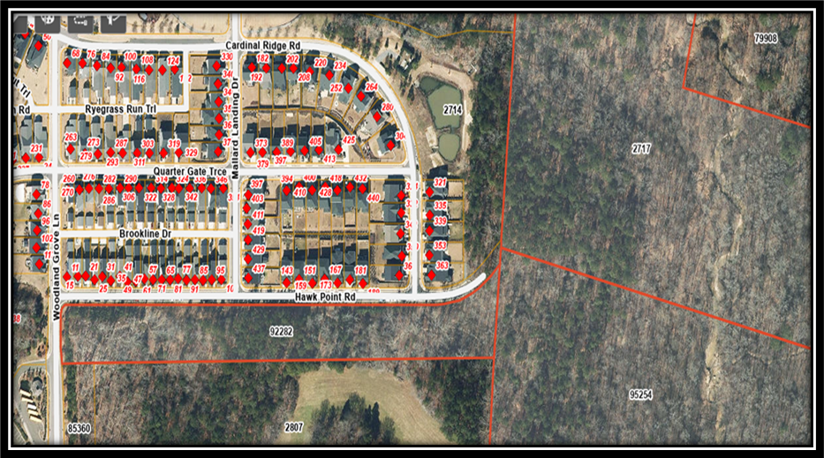
Discussion and Analysis
The request is for First Plat review and recommendation of Hawk Point Road Extension and realignment, located at the end of Hawk Point Road, on parcel 92282 extending to parcel 95254.

Slide 4
Discussion and Analysis
Community Meeting: A community meeting was held on January 12, 2022, at 697 Hillsboro Street, Pittsboro. Approximately eight people attended the meeting.
Roadways: Hawk Point Road is proposed to be built with a 40-foot-wide public right-of-way and is to be state maintained.
Historical: During the Technical Review Committee meeting on August 17, 2022, Sy Robbins, Chatham County Historical Association (CCHA), commented that should the site have future development to look for Native American activities.
Schools: n/a
General Environmental Documentation: No records for rare species, important natural communities, natural areas, and/or conservation/managed areas within the proposed project boundary.

Slide 5
Discussion and Analysis
General Environmental Documentation: Mr. Drew Blake, Watershed Protection Assistant Director, reviewed the information submitted. Mr. Blake replied in a letter dated July 12, 2022, that the requirement has been met.
Wavier: Board of Commissioners approved the buffer reduction request waiver on June 21, 2022.

Slide 6
Discussion and Analysis
Technical Review Committee: Met August 17, 2022, items discussed riparian buffer and floodplain needs to be shown on plat, any future development look for signs of Native American actives, and several items needed for the Utility Dept.
Septic: n/a
Water: Chatham County public water
Road Names: Hawk Point Road
Water Features: Two (2) perennial streams, one (1) potential wetland, and one (1) mapped floodplain were identified

Slide 7
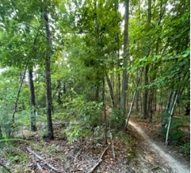
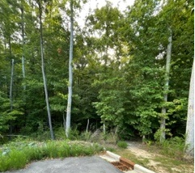
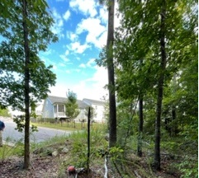
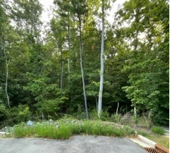
Discussion and Analysis
Stormwater and Erosion Control: n/a
Site Visit: The site visits were scheduled for August 18, 2022 and staff and advisory board members attended.

Slide 8
Comprehensive Plan Evaluation

Slide 9
Plan Chatham Evaluation
These properties are in an area of the county identified as compact residential on the Future Land Use and Conservation Plan Map. The description for compact residential includes a mix of detached and attached residential units, open spaces, some multifamily units, community centers, amenities, recreational uses, schools and churches may be a part of the fabric.

Slide 10
Planning Staff Recommendation
The Planning Department recommends granting approval of the road extension for Hawk Point Road Extension with following conditions:
Approval of the First Plat (Recombination Plat) shall be valid for a period of twelve (12) months following the date of approval by the Board of Commissioners and the Construction Plan approval shall be valid for a period of twenty-four (24) months from the date of approval by the Technical Review Committee or Board of Commissioners.
The county attorney shall review and approve the contract and performance guarantee prior to final plat recordation.

