Slide 1
Ovulation, Menstruation, and Conception
This presentation adapted for use in Chatham County Schools by the Chatham County Public Health Department from “Successfully Teaching Middle and High School Health” developed by the North Carolina School Health Training Center.
Leading the Charge to a Healthier Chatham.
Chatham County Public Health Department • L. Layton Long, Health Director • www.chathamnc.org/publichealth
Notes:
If doing anonymous questions, distribute questions sheets. Explain to students that they can use the sheets to ask questions that they would like to ask in private. At the end of the class, everyone will put a sheet in the box, that way we have no idea who asked what question. Either draw questions directly from the box and answer them in class, have another question session at a later date, or create an “answer sheet” that students can take home with all the answers on it.
Warm-Up: Bowl and Spoon
Time: 15 minutes
Materials Needed: “Background Content for Facilitating Bowl and Spoon Activity” (pg 6), “Items for Bowl and Spoon Activity” cut is strips and color coded (pg 7) (pink=female, blue=male, yellow=both), Bowl, Large Spoon
Directions:
Prior to class, cut “Items for Bowl and Spoon Activity” into strips (and/or put words on color coded paper).
Explain to students that today you will continue to talk about the reproductive system. You will first start out by reviewing the parts of the reproductive system.
Explain that the bowl represents the human body and the spoon represents hormones as they begin to function during puberty. The word hormone in Greek means “to stir things up.”
Walking around the room, stir bowl and have students draw strips one at a time, explaining to the class what occurs during puberty relative to that body part, function, or relationship. Clarify any misconceptions or mispronunciations using the “Background Content for Facilitating Bowl and Spoon Activity.” Use slide #2 as a reference to clarify any of the parts of the reproductive system.

Slide 2
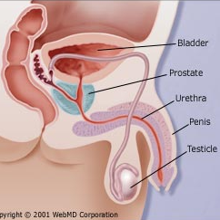
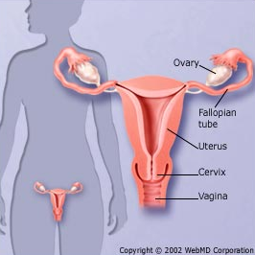
The Reproductive System
Male
Female
Notes:
Use this slide to clarify any parts of the reproductive system discussed during the “Bowl and Spoon” activity.

Slide 3
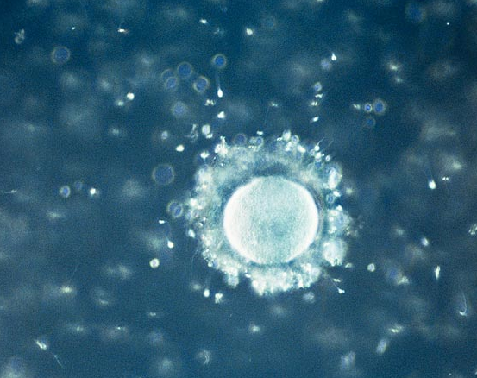
Conception
The process of becoming pregnant involving fertilization
Fertilization is when a sperm and ovum join
Only one sperm will fertilize the ovum
Notes:
Explain to students that today you are going to discuss ovulation, menstruation and conception. They are all parts of a cycle that can lead to pregnancy. You may be familiar with these words or you may have never heard them before. By the end of class, you will all understand what ovulation, menstruation and conception are and how they are related to each other.
Ask students, before we start can anyone remind me, What is the male sex cell? (Answer: sperm). What about the female sex cell? (Answer ova (plural) or ovum (singular)).
Explain that sperm and ovum are the beginnings of human life. These tiny cells together can grow into a human being. Conception is the process through which this happens.
Conception means the process of becoming pregnant involving fertilization. Fertilization is when the ovum, the female sex cell, joins with a sperm, the male sex cell. An ovum is about the size of a grain of salt. The sperm are too small to be seen without a microscope. Millions of sperm are released during ejaculation and a few hundred travel to the fallopian tubes (part of the female reproductive system we learned about in the last class). Only one sperm will enter the ovum, all others dissolve and leave the female body.
If you look up at the screen, the large white circle in the picture is the ovum as seen under a microscope. All around the ovum, you can see sperm, the white dots. Only one of these sperm will join with the ovum, thus fertilizing the ovum.
Today we’re going to talk more about the cycle that can lead to conception. First let’s do a little activity.

Slide 4
Activity: Mis-Conceptions about Conception
Notes:
Activity: Mis-Conceptions about Conception
Time: 5-7 minutes
Materials Needed: “6th Grade Puberty Presentation_Day 2” slides, Copies of “Myths about Conception and Pregnancy” (pg 8) (1 per 4-5 students), “Teachers Guide: Myths about Conception and Pregnancy” (pg 9)
Directions:
Divide students into groups of 4-5.
Distribute “Myths about Conception and Pregnancy” to groups.
Explain that each statement on the sheet is a myth, meaning it is not true.
Ask groups if they know why each statement is false.
Explain there are many misconceptions about conception. Use “Teachers Guide: Myths about Conception and Pregnancy” to explain why each statement on the handout is false.

Slide 5
Pronunciations
These terms are often mispronounced...
Ovulation: ahv-yoo-LAY-shun
Menstruation: men-stroo-A-shun
Conception: ken-sep-shen
Notes:
Transition by telling students many times individuals only talk about menstruation, also called your period, but we’ll be talking about ovulation, menstruation and conception. While menstruation, when a women gets her period, might be the most obvious, ovulation and conception are equally important as they represent the capacity to create a human life!
Before we start, let’s make sure we can pronounce them.

Slide 6
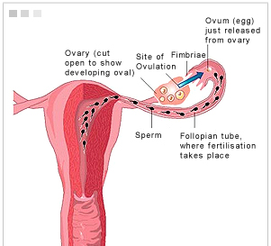
Ovulation
The release of a mature ovum from the ovary
Notes:
Explain, ovulation is when a mature ovum leaves an ovary. Unlike men, who produce new sperm daily throughout most of their lifetime, women are born with all their eggs, which are stored in their ovaries. To be more precise, a woman is born with about one to two million immature eggs, which are called follicles, in her ovaries.
Each month, with each menstrual cycle i.e. period, one follicle will mature into one ovum, which is released into the fallopian tube, kicking off ovulation. Of the millions of immature eggs that a women is born with only about 400,000 will ever actually mature into an ovum. When ovulation takes place, one ovum is released from one ovary and is guided into the fallopian tube by fimbriae, the finger like ends of the fallopian tube that you can see in the diagram.

Slide 7
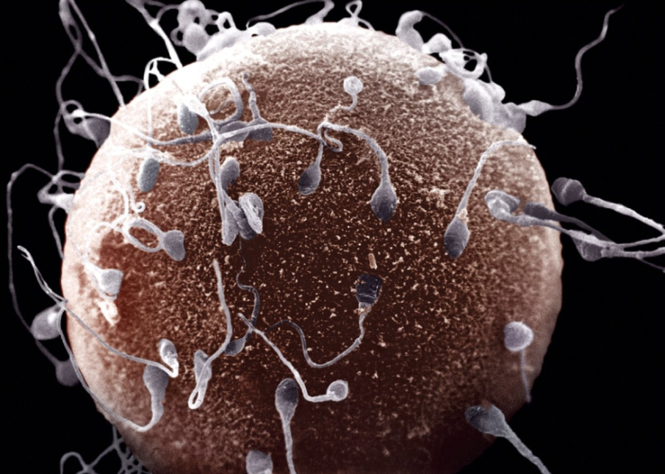
Conception
The joining of the ovum with a sperm cell, thus fertilizing the ovum
Only occurs if a women has had sexual intercourse
During sexual intercourse, millions of sperm are released
Only a few make it to the ovum
Only one sperm will penetrate the ovum
Notes:
Conception is the process of becoming pregnant. Pregnancy is when the ovum and sperm cell join together, which is called fertilization. If the women has vaginal intercourse, the ovum may met and join with a sperm cell from the man. During sexual intercourse millions of sperm are released from the man, but only a few hundred will make it to the ovum. Each sperm has a long tail to propel it, so it's well equipped to swim up to the fallopian tube, where fertilization of the egg takes place. Although many sperm cluster around the ovum, as you can see in the picture, and try to penetrate its outer layer, only one of them will manage to burrow its way through the surface and fertilize the egg. Once this happens, the egg's outer layer thickens quickly to keep out other competing sperm, so that each egg can be fertilized by only one sperm.

Slide 8
Menstruation
The discharging of blood secretions and tissue debris from the uterus
A female’s first menstruation is called menarche
Menarche usually occurs between 11 and 14
Menstruation is completely normal, and all women menstruate
Notes:
Menstruation, also called your period, is the discharging of blood, secretions, and tissue debris from the uterus out through the vagina. Once a women has her period, it marks the time the she is physically able to reproduce, meaning have a baby. Though the body is capable of having a baby, it does not always mean that an individual is physically or emotionally ready to have a baby.
Starting your period is a big stage in puberty for girls. Prior to her first period, called menarche, a young women will have had earlier developments, such as pubic hair and breast development before getting her period. Most girls will have their first period between the ages of 9 and 14. But some girls will start as early as 8, others as late as 17. The bleeding will last for a few days and usually happens every month. This bleeding is nothing to be scared of, menstruation is completely normal and all women get their period.
Menopause is a normal change in a women’s life when her period stops completely. Menopause usually occurs between the ages of 45 to 55 years old, although as we discussed before, women get their period at different times and go through menopause at different times as well. When a woman is finished with menopause, this means that she is no longer able to become pregnant.

Slide 9
!
?
!
?
!
Questions
!
!
?
?
Notes:
If doing anonymous questions, remind students to keep writing down any questions that they may have that they want to ask in private.

Slide 10
Why talk about these together?
Notes:
Explain to students, that we talk about ovulation, conception and menstruation because they are all part of the process than can lead to a pregnancy.

Slide 11
Ovulation
Has the women had sexual intercourse?
Yes
No
Did the ovum join with a sperm?
Yes
No
Conception
Menstruation
Notes:
Explain to students that the flow chart on the screen shows how ovulation , conception and menstruation are related.

Slide 12
Ovulation
Has the women had sexual intercourse?
Yes
No
Did the ovum join with a sperm?
Yes
No
Conception
Menstruation
Notes:
Starting at the top of the chart with ovulation. All women of child-bearing age ovulate (animation- click).
(animation- click) Ovulation can either lead to conception or menstruation. To determine which it may lead to, we need to ask the question “Has the women had sexual intercourse?”
(animation- click) If the answer is “Yes,” then we ask, “Did the ovum join with a sperm?” (animation- click)
If the answer is “Yes”. (animation- click) Then conception has occurred. (animation- click)
(animation- click) If the answer to “Did the ovum join with the sperm” is no, then menstruation occurs.

Slide 13
Ovulation
Has the women had sexual intercourse?
Yes
No
Menstruation
Notes:
Starting at the top again, remembering all women of child-bearing age ovulate (animation-click).
(animation- click) We again ask “Has the women had sexual intercourse?
(animation- click) If the answer instead is “No,” (animation- click) then menstruation occurs.

Slide 14
So what does it mean if conception occurs?
Notes:
Explain to students that now we will talk more in depth about what it means if conception occurs. Remember, conception is the joining of the ovum with a sperm cell, thus fertilizing the ovum.

Slide 15
Ovulation
Has the women had sexual intercourse?
Yes
No
Did the ovum join with a sperm?
Yes
No
Conception
Notes:
Looking back at our flowchart, this means that the women has had sexual intercourse AND the ovum joined with a sperm.

Slide 16
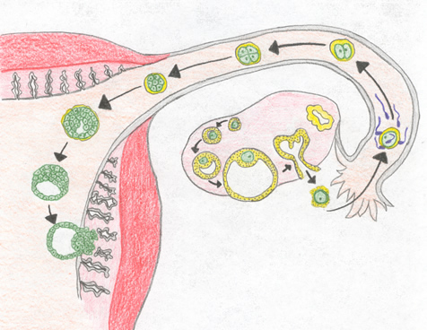
Conception
The joining of the ovum with a sperm cell, thus fertilizing the ovum
Implantation
Fertilization
Endometrium
Notes:
Once conception occurs, the fertilized ovum is called a zygote. The zygote travels down the fallopian tube into the uterus and implants in the uterine wall, which is called the endometrium. When the zygote implants in the endometrium, this means that the women is now pregnant.

Slide 17
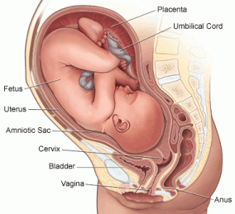
Pregnancy
The condition of having a developing child within the body, follow conception.
A baby growing in the uterus, is called a fetus
From conception to birth, pregnancy takes about 40 weeks (9 months)
Very important that the mother take care of herself and baby during this time
Notes:
After implanting in the uterine lining, the zygote begins to divide and grow into a baby. As the baby grows in the uterus, it is called a fetus. The uterus also expands to allow the baby to get bigger.
From conception to birth, pregnancy takes about 40 weeks (a little more than 9 months). While pregnant, the mother needs to properly take care of herself and the baby. This means she should eat good nutritious food, gain the proper amount of weight (not too much and not too little). She should also avoid alcohol, tobacco and other drugs as these can hurt the growing baby. She also needs to visit the doctor regularly to make sure that the baby is growing and developing normally.

Slide 18
!
?
!
?
!
Questions
!
!
?
?
Notes:
If doing anonymous questions, remind students to keep writing down any questions that they may have that they want to ask in private.

Slide 19
What about twins?
Notes:
A question that many students ask is, what about twins?

Slide 20
Identical Twins
Fraternal Twins
Share same DNA
Always same sex, two boys or two girls
No more alike than any two siblings
Can be a boy and girl
Notes:
Twins occur when a women is pregnant when more than one child. This is called multiple births, because there are multiple children. Twins are the most common form of multiples, though women can have three babies, called triplets, or even more!
Twins can be identical, meaning they have the same genetic information, called DNA. Identical twins are always the same sex, meaning girl-girl or boy-boy.
Twins can also be fraternal, meaning they are no more a like than any other siblings. Fraternal twins can be a boy-girl, girl-girl, or boy-boy.

Slide 21
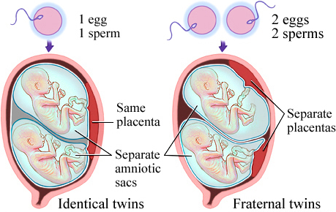
How do twins happen?
Notes:
Identical and fraternal twins happen differently.
With identical twins, one sperm fertilizes one ovum (animation-click), then the zygote splits into two identical parts (animation-click). This is why identical twins are identical, they originated from the same sperm and ovum, meaning they have all the same genetic information, the coding that dictates hair color, eye color, and other traits.
With fraternal twins, two ova are released and fertilized by two different sperm (animation-click) and the zygotes share the womb during pregnancy (animation-click). This is why fraternal twins can look very different and even be different sexes!

Slide 22
So what does it mean if menstruation occurs?
Notes:
Now we will talk a little about the other outcome, menstruation. Remember, menstruation, or having one’s period, is the discharging of blood secretions and tissue debris from the uterus.

Slide 23
Ovulation
Has the women had sexual intercourse?
Yes
No
Did the ovum join with a sperm?
Yes
No
Menstruation
Notes:
Looking back at our flowchart, there are two paths to menstruation.
The first path, we ask “Has the women had sexual intercourse?” If the answer is no, the women has not sexual intercourse recently (animation-click), then she will menstruate or have her period (animation-click).
The second path, we ask “Has the women had sexual intercourse?” If the answer is yes (animation-click), but the ovum did not join with a sperm (animation-click), she will menstruate or have her period (animation-click).
It is important to note, if a woman has had sexual intercourse that the ovum can join with a sperm at any time throughout her ovulation-menstruation cycle. One should be careful to avoid pregnancy anytime that they have sexual intercourse (utilize condoms, birth control).

Slide 24
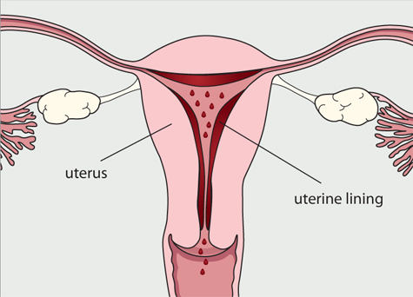
Menstruation
The discharging of blood secretions and tissue debris from the uterus
Notes:
Menstruation is the technical term for getting one’s period. Each month before ovulation, the female body prepares for the possibility of pregnancy. This means that the endometrium, remember that is the lining of the uterus, begins to get thicker in case there is a fertilized ovum to implant. However, if fertilization does not occur, the lining is no longer needed and thins out and leaves the body. The process of this lining leaving the body is menstruation.
The dissolving of the endometrium (or menstrual blood) is a normal process for girls and women during their reproductive years.

Slide 25
Sequence of
Ovulation - Menstruation
Notes:
Now that we’ve looked at the pathways to conception and menstruation, we will look at how conception, menstruation and ovulation are all part of the same cycle.

Slide 26
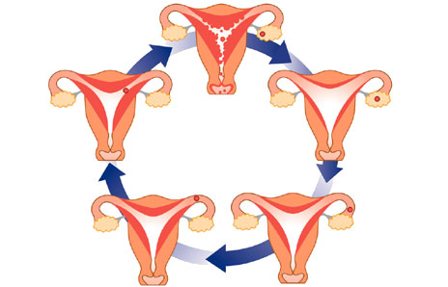
Menstrual flow begins and lasts 3-7 days
If not fertilized ovum passes from the body
Lining of the uterus begins to thicken
Ovum travels down fallopian tube to uterus
Ovum is released from one of the ovaries
Notes:
Conception, menstruation and ovulation are all part of a cycle. Let’s take a look at this cycle:
Walk students through the following steps of the ovulation-menstruation cycle (animated, click before each step):
Menstrual flow (period) begins and lasts about 3-7 days. The exact length of time is unique for individual women.
The period stops, and the lining of the uterus begins to get thicker in preparation for a potential pregnancy.
Ovulation occurs and the ovum is released from one of the ovaries.
The ovum then travels down the fallopian tube to uterus. Remember back to the flow chart we looked at, here the ovum can either join with a sperm, thus fertilizing the egg.
If the ovum does not meet with the sperm, then it passes from the body with the next menstrual cycle.
The cycle then starts all over again.

Slide 27
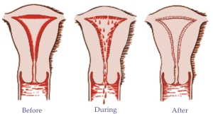
The O-M Cycle
Lasts on average 28 or 29 days (though ranges from 20-35)
Ovulation usually occurs 14 days prior to menstruation (may occur earlier, later or not at all)
Menstruation averages 5 days (ranges from 3-7)
Notes:
This cycle usually lasts on average 28 or 29 days, though it can range from 20-35 depending on the individual women (everyone is a little different). Ovulation usually occurs 14 days prior to menstruation, though it may occur earlier, later or not at all for some women. Then menstruation lasts on average between three to seven days.

Slide 28
The O-M Cycle
Other factors related to conception…
Sperm from male can live an average length of about 3 days
Ovum may be viable for several days after ovulation
Notes:
In addition to the ovulation- menstruation cycle, there are some additional factors to consider that lead to conception.
Sperm from males can live an average length of about 3 days (though ranges from 1½ to 7 days).
Ovum may be viable for several days after ovulation.

Slide 29
The O-M Cycle
Because a female cannot accurately predict when she will ovulate
AND
A male does not know how long his sperm will live
A couple CANNOT predict for certain of pregnancy will or will not happen at any given time based on the calendar alone!
Notes:
These two factors are important because when combined with the variability of the ovulation-menstration cycle it is nearly impossible to accurately predict when a women will ovulate and furthermore how long the sperm will live. Therefore, a couple cannot predict for certain if pregnancy will or will not happen at any given time based on the calendar alone!
If one is sexually active, that means having vaginal intercourse, they should use other forms of protection to prevent pregnancy besides knowing your cycle.

Slide 30
Activity: Sequencing the O-M Cycle
Notes:
Activity: Sequence the O-M Cycle
Time: 5-10 minutes
Materials Needed: Signs created from “Sequencing the O-M Cycle” (pg 10-12), Teacher key for “Sequencing the O-M Cycle” (pg 13)
Directions:
Print Signs from “Sequencing the O-M Cycle” on colorful paper.
Distribute the signs to six students and ask them to post them in the proper sequence on the board in the front of the room.
Ask remaining students if the sequence is correct. Clear up any misconceptions using the “Teacher Key for “Sequencing the O-M” Cycle.”

Slide 31
!
?
!
?
!
Questions
!
!
?
?
Notes:
If doing anonymous questions, remind students to keep writing down any questions that they may have that they want to ask in private.

Slide 32
We’ve Learned…
About puberty…
Puberty is a time of changes
Marks the beginning of reproductive capacity
Everyone goes through puberty differently
About the reproductive system…
Works to make it possible for a man and a women to conceive a child
The parts and functions of the male and female reproductive system
Notes:
Tell students, in our last class we discussed the changes that come with puberty. Puberty is defined as the development of secondary sex characteristics and the beginning of reproductive capacity, meaning that you are able to become a parent. Many of you have started or will start puberty very soon. This is a time of changes, physical, emotional, or social. Remember that each person will goes through this process of changes differently, and you should always be a kind and supportive peer.
We also reviewed the reproductive system. Remember, the reproductive system works to make it possible for a man and a women to conceive a child, called pregnancy. In the last class we learned each of the organs of the male and female reproductive system and how they develop and eventually function to create a human life.

Slide 33
We’ve Learned…
About ovulation, menstruation and conception…
Ovulation is the release of the ovum
Conception is the joining of the sperm and ovum to create a zygote
Menstruation occurs when the ovum is not fertilized
Remember it is very difficult to predict this process!
Notes:
Today we talked more about the reproductive system, specifically how the ovulation, conception, menstruation cycle can lead to a pregnancy. Ovulation is the release of the ovum from the ovary. Conception is the joining of the male sex cell, sperm, and female sex cell, ovum, to create a fertilized egg, or zygote. If the zygote implants in the women’s uterus, it will grow and develop into a baby. Menstruation, often called a period, occurs when the ovum released is not fertilized. Remember it is very difficult for adult women to predict when they can and cannot become pregnant based on the ovulation-menstruation cycle. This is even harder for young women, as the menstrual cycle is often still irregular. If one is sexually active, and does not wish to become pregnant, they should always use forms of protection.

Slide 34
!
?
!
?
!
Questions
!
!
?
?
Notes:
If doing anonymous questions, remind students to keep writing down any questions that they may have that they want to ask in private.

Slide 35
What to do about your period?
Notes:
When doing this presentation, there are often a lot of questions about periods. We know that girls your age are starting to get their period or may soon get their period in the next few years. We want to emphasis that getting your period is normal, almost all women experience it, and you really should not feel negative about it. It means you are growing and maturing into an adult and that's exciting, so don't feel ashamed about it. Yes it can be a difficult to deal with at times, but with knowledge about what to expect and how to handle your periods, it can be easy.
It is important to remember to take a bath or shower at least once a day when you have your period to keep clean and reduce any odor. You also will want to buy and have ready, in the bathroom at home as well as in your locker or backpack at school, either pads or tampons so you are always prepared in case you get your period unexpectedly.

Slide 36
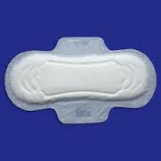
Period Supplies
Pads
Rectangles of absorbent material that attaches to the inside of a girl’s underwear and absorbs blood.
Change often (at least every 3 to 4 hours) to prevent the buildup of bacteria and eliminate odor.
Notes:
Some of you may already be familiar with the next information but we want to talk about what your options are. Once you get your period, you'll need to use something to soak up the menstrual blood. There are lots of choices out there, and it may take some experimenting before you find the product that works best for you.
First, lets talk about pads. Pads are placed on the inside of a girl’s underwear (there is a sticky side so it sticks to your underwear). There are many different types of pads: Super, slender, overnight, with or without wings, deodorant, maxi, mini and cloth pads. What you use will depend on how heavy your menstrual flow is and what your personal preferences are. Some pads are scented or come with a deodorant in them. Be cautious when using scented pads, these can cause irritation of the vagina or an allergic reaction in some girls.
Also, don't try to flush a pad down the toilet — even the lightest kind of pad may back up the toilet and make a huge (embarrassing!) mess. Just wrap it up in some toilet paper and throw it away in the trash receptacle found in each stall. If there isn’t one in the stall, you can place the wrapped up pad in the main trash can.
It's also possible to buy reusable pads that can be washed after each wearing — these are usually available in natural health stores or online. Some women choose to use these pads because they think they are better for the environment or because they save money. It's all a matter of personal preference. No matter what kind of pad you choose, it's best to change pads every 3 or 4 hours, even when your flow isn't very heavy.

Slide 37
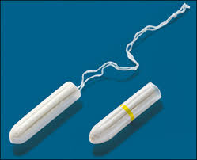
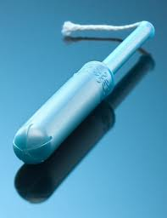
Period Supplies
Tampons
Absorbent material that is compressed into a tiny tubular shape.
Absorbs blood from inside the vagina.
Wash hands before use and follow directions.
Change often, at least every 4-6 hours.
Notes:
Like pads, tampons come in different sizes and absorbencies for heavier and lighter periods (words like "super" or "ultra" on the packaging usually mean that a tampon is designed for girls whose flow is heavier). Tampons can also come with or without deodorant. There's no real need for deodorant in a tampon, since regular changing usually gets rid of any odor. The deodorant in tampons can irritate the vagina, and could cause an allergic reaction in some girls. It's easy to use a tampon, but you do need to learn how. After washing your hands, follow the directions that come with the tampons carefully and be sure to relax. Some tampons come with an applicator — a plastic or cardboard tube that guides the tampon into the vagina. Other tampons are inserted with the fingers. If a tampon is left in too long, it won't get lost. But a girl may get a discharge and odor, and she could develop an infection. That's why it's important to change tampons often (every 4-6 hours). Once you remove a tampon it is best to wrap it up in toilet paper and throw it away in the trash receptacle found in each stall. Don't flush a tampon down the toilet — even when the box says a tampon is flushable, some tampons can still cause problems in some plumbing systems. One thing to remember about tampons: It's very important that you change them every few hours and that you wear the absorbency type that is right for you.
Never put a tampon in and leave it in all day or all night, thinking that you won't need to change it because your period is so light. Doing this puts girls at risk for a rare but very dangerous — and sometimes life-threatening — disease called toxic shock syndrome (TSS). TSS results from a bacterial infection that may occur when using super-absorbent tampons, especially if they are left in longer than is recommended.

Slide 38
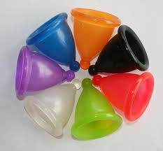
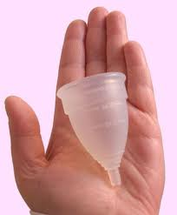
Period Supplies
Menstrual Cups
A cup made of flexible material.
Inserted into the vagina where it catches the blood.
Wash hands before use and follow directions.
Needs to be emptied several times a day.
Notes:
Another option is a menstrual cup, sometimes called a diva cup. This is less commonly used than pads and tampons, but some women prefer them because they are reusable. Like a tampon, a menstrual cup is inserted into the vagina. Instead of absorbing blood, though, the cup catches it before it flows out of the vagina. Menstrual cups are made of flexible materials, like rubber or silicone. Since you can't see when the cup is full, it will need to be emptied several times a day. Instructions that come with the cup explain how to do this. Because menstrual cups are not as commonly used as tampons and pads, they may be harder to find in the stores.

Slide 39
Optional Activity: Independent Practice
Notes:
Optional Activity: Independent Practice
Time: 30 - 45 minutes
Materials Needed: Copies of “Counting the Days” (pg 14) (1 per student), Teacher key for “Counting the Days” (pg 15)
Directions:
Start by having students recall why there is no “safe” time of the O-M cycle (during which pregnancy can be prevented by simply avoiding sexual intercourse). (Answer: Factors which influence the timing of conception include: how regular a female’s cycle is, how long sperm live after sexual intercourse, how long the ovum is viable (able to be fertilized). Young females find it especially difficult to predict when they will ovulate because their reproductive organs are still developing and their cycles are often very irregular.)
Distribute copies of “Counting the Days” to each student.
Assign the date of March 7 as day one of a young woman’s cycle. Explain, because the first day of menstrual flow is the most obvious day of the O-M cycle, it is recognized as day one.
We will assume this female has a regular 28-day cycle. In this activity, we will count forward 28 days, beginning with March 7.
The first day of the next cycle is therefore, April 4. Place an M on March 7 and April 4.
If we count backwards from April 3, the most likely date for ovulation to have occurred is March 21. Have students place an “O” on March 21.
Instruct students to continue counting the most likely dates for menstruation and ovulation to occur during the months on the calendar. Double check the responses with the teacher key.
Re-emphasize the concept that avoiding pregnancy by counting days within the O-M cycle is very hard to do. Adult women who have much more regular cycles have difficulty preventing pregnancy through counting the days. It is much harder for younger females whose cycles are less reliable.

