Slide 1
Changes & Influences during Puberty
This presentation adapted for use in Chatham County Schools by the Chatham County Public Health Department from “Successfully Teaching Middle and High School Health” developed by the North Carolina School Health Training Center.
Leading the Charge to a Healthier Chatham.
Chatham County Public Health Department • L. Layton Long, Health Director • www.chathamnc.org/publichealth
Notes:
Today we will talk about changes that happen as part of growth and development. These changes are called puberty and all boys and girls experience it as they become men and women. Explain to students that first we will do an activity to get us thinking about puberty.
If doing anonymous questions, distribute questions sheets. Explain to students that they can use the sheets to ask questions that they would like to ask in private. At the end of the class, everyone will put a sheet in the box, that way we have no idea who asked what question. Either draw questions directly from the box and answer them in class, have another question session at a later date, or create an “answer sheet” that students can take home with all the answers on it.

Slide 2
Activity
Puberty Walk
Notes:
Warm-Up: Puberty Walk
Time: 7-10 minutes
Materials Needed: None
Directions:
Ask students to move to one area of the room.
Tell them that you when you tap them on the shoulder they should walk (not run) to a designated location on the opposite side of the room. Note: If you have a large group or would like the activity to take less time, ask for a smaller group of volunteers.
Tap students on the shoulder, starting with one student. Let the first student walk to the other side of the room, then tap another student. Continue tapping students, first slowly, then speeding up, tapping groups and individuals. Toward the end slow down tapping individuals. Leave a few students to walk across alone at the end.
When all students have walked to the other side of the room, ask students:
How did it feel to be the first one to walk?
How did it feel to be the last one to walk?
Did it feel better to walk alone or in a group? Why?
Lead a discussion using the students’ answers to make the transition that this walk is very much like puberty- Just like everyone eventually walked across the room, eventually everyone will go through puberty. Some people start earlier and will finish before their peers, others will start later. And just like everyone walked at a different pace across the room, everyone moves through puberty differently.
Puberty is defined as development of secondary sex characteristics (such as pubic hair) and the beginning of reproductive capacity (being able to become a parent).
Adolescence is the transition from childhood to adulthood. These changes are exciting and fun, but at other times can cause a young person to become confused and awkward. There are social and emotional changes as well as physical ones. Remember each person goes through puberty and adolescence at his/her own pace.
Transition by telling students that we will now discuss the physical and emotional changes that happen during puberty.

Slide 3
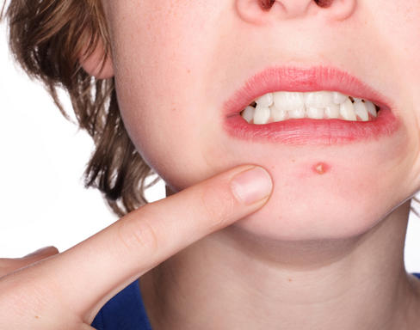
pu·ber·ty noun \ˈpyü-bər-tē\
A time in your life when your body makes changes that causes you to develop from a child into an adult.
PHYSICAL
EMOTIONAL
SOCIAL
Notes:
Explain, you are all at a very important time in your reproductive development. Many of you who have older brothers, sisters or cousins may have noticed that they have experienced changes in the way they look. They have begun to look more like young men and women and less like children. These changes may have already started for you or they may be beginning within the next several years. These changes are called puberty.
There will be many changes that come with puberty, both physical changes and emotional changes. These changes are often exciting and fun, but at other times can cause a young person to become confused, awkward, or embarrassed. There can also be social changes that happen during puberty, and you may find that your friends and friendships change. This is all normal, and as we discussed with our first activity, will happen at different times in everyone’s life.
Some of you may know a lot about changes related to puberty, your body, and the reproductive system, while others may not have seen or heard about this before. The reproductive system works to make it possible for a man and a women to conceive a child, called pregnancy. Men and women are born with organs that will develop and eventually function to create a human life. In both males and females, the outside parts of the reproductive system are called the genitals.
Sometimes children (and adults) feel uncomfortable talking about puberty. It is natural for folks to feel a little embarrassed, especially if they have not talked about these topics before. They may feel silly and may giggle or get quiet. That’s to be expected and we’re okay with a little of that in class. Some of you may know a lot about these things, while others may not have seen or heard about this before. Make sure to ask questions if you have them, because chances are if you have a question someone else does too!

Slide 4
MALES
FEMALES
Testosterone
Estrogen & Progesterone
Between ages 10-15
Voice deepens
Penis & testicles grow
Shoulders broaden
Hips narrow
Chest hair grows
Nocturnal emissions
Growth spurt
Oily skin and scalp
Sweat
Body Odor
Body hair grows
Acne
Between ages 9-13
Hips widen
Breasts enlarge
Begin menstruation (period)
Vaginal discharge
Notes:
For both males and females the changes related to puberty are triggered on by hormones. A hormone is a chemical released by the body. Hormones act as messengers. They send messages from one part of the body to another. All living things have hormones. There are many different kinds of hormones. Each gives a different signal to the body. The hormones released during puberty are responsible for communicating the changes from child to adult. For girls, there are two hormones responsible for puberty, estrogen and progesterone. For males, there is one, testosterone.
During puberty, your body is changing from being a child to being an adult in preparation to be able to reproduce, or have a child one day. Here are some of the physical changes that happen during puberty, as the body is transitioning from childhood to adulthood:
For males, these changes typically begin between the ages of 10 and 15. During puberty the hormone testosterone causes boys’ voices to get deeper, their shoulders to broaden and their hips to narrow. Boys will also start growing chest and other facial hair, their penis and testicles develop more, and they may experience nocturnal emissions, or what are known as wet dreams.
For females, puberty usually happens earlier than for boys, between the ages of 9-13 years old. In girls, the hormones estrogen and progesterone cause changes like widening of the hips, enlargement of the breasts, and the beginning of monthly menstruation, also called your period. Girls can also experience vaginal discharge during this time.
In both males and females, increased levels of hormones in the body can cause growth spurts, oily skin and scalp, increased sweat and body odor, and increased body hair and acne.

Slide 5
EMOTIONAL & SOCIAL
Notes:
Just as those hormones create changes in the way your body looks on the outside, they also create changes on the inside. While your body is adjusting to all the new hormones, so is your mind. During puberty, you might feel confused or have strong emotions that you've never experienced before. You may feel anxious about how your changing body looks. You might feel overly sensitive or become easily upset. Some teens lose their tempers more than usual and get angry at their friends or families. Other emotions may include: aggressive, moody, mixed feelings, and being sentimental.
You might have new, confusing feelings about sex — and lot of questions. The adult hormones estrogen and testosterone are signals that your body is giving you new responsibilities, like the ability to create a child. That's why it's important to get all your questions answered. Some teens can talk to their parents about and get all their questions answered. But if you feel funny talking to your parents, there are many other people to talk to, like your doctor, a school nurse, a teacher, a school counselor, or another adult you feel comfortable talking with.

Slide 6
Puberty is a time of changes
We all have our own body clock
Changes can be physical and emotional
It’s not a race
Notes:
To summarize, the bottom line is that puberty is a time of changes. These changes are different for everyone. Each person will start puberty at a different age, based on their own body clock. Girls may start noticing changes any time between about ages 8 or 9 to 13. Boys, on average, start noticing changes a little later, between about ages 9 or 10 to 15. And puberty isn’t an overnight process; it can take several years to complete. Puberty takes longer in boys, on average, than girls.
Your body is developing both physically and emotionally into an adult. These changes can feel scary or confusing. But, at the same time, they can be exciting-- You are becoming your adult self! This is not a painful process.
And it isn’t a race, anyway! We all will eventually develop when our bodies are supposed to develop. And remember that puberty involves changes in not only your body but also your feelings and relationships. So your friend’s body might start maturing first, but you may be maturing emotionally and socially sooner than your friend.

Slide 7
!
?
!
?
!
Questions
!
!
?
?
Notes:
Ask students, “Does anyone have any questions?”
If doing anonymous questions, remind students to keep writing down any questions that they may have that they want to ask in private.

Slide 8
The Reproductive System
Notes:
Now we are going to continue by reviewing the reproductive system. The body is comprised of several systems such as the digestive system, the skeletal system, and the circulatory system. A system is made up of organs which work together to perform a vital function. Today we are going to discuss the reproductive system for both men and women. Some of you may know a lot about the reproductive system, while others may not have seen or heard about this before. We are going to start by reviewing the reproductive system.
Distribute “Reproductive Anatomy” handout to each student (pg 7-8 of Teacher Guide). Instruct students to fill out the names of the body parts and what that body part does in their own words as the class goes through the following slides.

Slide 9
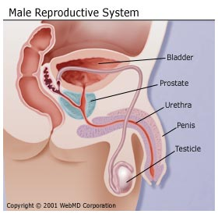
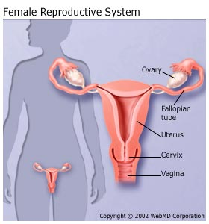
The Reproductive System
Male
Female
Notes:
Explain that on the screen are diagrams of the male and female reproductive systems. The reproductive system works to make it possible for a man and a women to conceive a child.
To begin with today, let’s first talk about what sexual intercourse is so that we all understand what we are talking about. Sexual intercourse is intimate sexual behavior that may include oral, anal, or vaginal sex. Vaginal intercourse is an act which might result in a baby developing in the mother.
Male sex cells are called sperm. Female sex cells are called ova (or ovum for just one). Both female and male sex cells contain half of the genetic information, the coding for traits such as sex, hair color and eye color. Both a female and male sex cell are needed to conceive a baby.
If the egg and the sperm meet, and the fertilized egg is implanted in the women’s uterus, the women is pregnant and the baby is born about nine months later.
So to get started we will talk about the differences between the males and female systems. Men and women are born with organs that will develop and eventually function to create a human life. We will first review the male reproductive system, then the female. In both males and females, the outside parts of the reproductive system are called the genitals.
We are now going to pass out a work sheet that you will use to take notes during the next slides. Follow along on your work sheet, writing in the name and what that body part does in your own words. You will be able to keep this worksheet for you to look back on in the future. Also bring it with you to our next session to help with in class.

Slide 10
Male Reproductive System
Bladder
Prostate Gland
Urethra
Penis
Testicle
Vas Deferens
Epididymis
Scrotum
Notes:
We will first talk about the male reproductive system. The male reproductive organs are responsible for creating sperm, the male sex cell. Both female and male sex cells contain half of the genetic information, the coding for traits such as sex, hair color and eye color. Both a female and male sex cell are needed to conceive a baby. We’ll talk more about the female sex cell when we go over the female reproductive system. As we review each part, make sure to write down the name and it’s function on your worksheet.
Let’s now look at the different organs that make up the male reproductive system.

Slide 11
Male Reproductive System
Bladder
Bladder
blah-der
The bladder is not actually part of the male reproductive system, but is shown in this diagram for reference.
Prostate Gland
Urethra
Penis
Vas Deferens
Testicle
Epididymis
Scrotum
Notes:
It is important to note that the bladder is in the picture but not actually part of the male reproductive system, it is only in the diagram for reference. The bladder is part of the urinary tract. Who can tell me what the function of the bladder is in both men and women?
[Answer: The bladder stores urine until you are ready to use the bathroom]
(Remind students to fill in the worksheet)

Slide 12
Male Reproductive System
Bladder
Prostate Gland
pra-state gland
One of several glands in the male which secrete fluid to make up semen, which carry the sperm.
Prostate Gland
Urethra
Penis
Vas Deferens
Testicle
Epididymis
Scrotum
Notes:
The prostate gland is one of several glands in the male system which secrete fluid to make up semen. Semen carries sperm along with a mixture of fluids created by the prostate gland and other organs.
(Remind students to fill in the worksheet)

Slide 13
Male Reproductive System
Bladder
Urethra
your-eeth-ra
A tube-like organ which carries urine from the body in females and urine and semen from the body in males.
Prostate Gland
Urethra
Penis
Vas Deferens
Testicle
Epididymis
Scrotum
Notes:
The urethra is a tube-like organ which carries urine from the bladder away from the body in females and both urine and sperm from the body in males. The male body has a system that keeps it from being able to release sperm and urinate at the same time. During an erection, muscles at the base of the bladder contract in order to close off the passageway from the bladder into the urethra. This makes it impossible for urine to be released at the same time as semen.
It is important to note that in women it is different. The urethra is not connected to the female reproductive system at all.
(Remind students to fill in the worksheet)

Slide 14
Male Reproductive System
Bladder
Penis
pea-niss
Male organ for sexual intercourse.
Prostate Gland
Urethra
Penis
Vas Deferens
Testicle
Epididymis
Scrotum
Notes:
Next is the penis which lies outside the body. This is the male organ necessary for intercourse.
(Remind students to fill in the worksheet)

Slide 15
Male Reproductive System
Bladder
Testicle
test-tick-ole
Male reproductive organs which lie outside the body (in the scrotum) and produce sperm.
Prostate Gland
Urethra
Penis
Vas Deferens
Testicle
Epididymis
Scrotum
Notes:
The testicles are male reproductive organs which also lie outside the body (in the scrotum). The testicles are the organ that produce sperm.
(Remind students to fill in the worksheet)

Slide 16
Male Reproductive System
Bladder
Scrotum
scrow-tum
Pouch which contains the testicles outside the male body.
Prostate Gland
Urethra
Penis
Vas Deferens
Testicle
Epididymis
Scrotum
Notes:
The scrotum is a pouch which contains the testicles outside the male body. The scrotum helps to regulate the temperature of the testicles, which is important for the production of sperm.
(Remind students to fill in the worksheet)

Slide 17
Male Reproductive System
Bladder
Epidiymis
ep-id-did-e-mus
Organ in which the sperm mature before being released from the male.
Prostate Gland
Urethra
Penis
Vas Deferens
Testicle
Epididymis
Scrotum
Notes:
The epidiymis (ep-pid-di-e-mis) is a tightly coiled, skinny tube that is about six meters in length. This is where the sperm mature before being released from the male.
(Remind students to fill in the worksheet)

Slide 18
Male Reproductive System
Bladder
Vas Deferens
vas def-er-ens
Tube that carries sperm from the epididymis to the penis.
Prostate Gland
Urethra
Penis
Vas Deferens
Testicle
Epididymis
Scrotum
Notes:
The Vas Deferens are tubes that carry sperm from the epididymis (ep-pid-di-e-mis) to the penis. If you remember from before, sperm join with fluids from the prostate gland and other glands to form the liquid, semen, which is transported by the Vas Deferens.
(Remind students to fill in the worksheet)

Slide 19
!
?
!
?
!
Questions
!
!
?
?
Notes:
Ask students, “Does anyone have any questions?”
If doing anonymous questions, remind students to keep writing down any questions that they may have that they want to ask in private.

Slide 20
Female Reproductive System
Ovary
Ovaries
Fallopian Tube
Fallopian Tubes
Breasts
Breasts
Uterus
Uterus
Cervix
Cervix
Vagina
Vagina
Labia
Labia
Notes:
We will now discuss the female reproductive systems. The different organs, or parts, of the female reproductive system, as seen on this slide, once mature are what make it possible for a women to become pregnant and have a baby.
Let’s review the organs we see on the screen. Remember to follow along on your work sheet, writing in the organ name and a brief description of each part in your own words.

Slide 21
Female Reproductive System
Ovaries
Ovaries
o-var-ees
Female reproductive organs which produce eggs (ova).
Ovary
Fallopian Tube
Fallopian Tubes
Breasts
Breasts
Uterus
Uterus
Cervix
Cervix
Vagina
Vagina
Labia
Labia
Notes:
We will start at the top of the diagram and move down.
The ovaries, are the female reproductive organs that produce eggs or ova. Ova are the female sex cell, or eggs. The ova carries half of the genetic code, the information such as hair color and eye color, that form a baby. We will talk more about ova in our next class.
If you look at the diagram, there are two ovaries, one on each side. The singular form of ovaries is ovary.
(Remind students to fill in the worksheet)

Slide 22
Female Reproductive System
Ovaries
Uterus
you-ter-us
The muscular organ in the female where the baby develops during pregnancy. Also called the womb.
Ovary
Fallopian Tube
Fallopian Tubes
Breasts
Breasts
Uterus
Uterus
Cervix
Cervix
Vagina
Vagina
Labia
Labia
Notes:
We’re going to skip the fallopian tubes for a minute, but we’ll come back to them.
Let’s go down to this next box, the uterus. The uterus is a muscular organ where the baby develops during pregnancy. The muscles of the uterus contract to push the baby out during birth. The uterus is sometimes also called the womb. When women get their period, the period comes from the uterus. We will talk a lot more about periods at our next class.
(Remind students to fill in the worksheet)

Slide 23
Female Reproductive System
Ovaries
Fallopian Tubes
fa-lo-pee-an toobs
Tubes between ovaries and uterus in which egg and sperm are joined.
Ovary
Fallopian Tube
Fallopian Tubes
Breasts
Breasts
Uterus
Uterus
Cervix
Cervix
Vagina
Vagina
Labia
Labia
Notes:
Now, let’s go back now to the fallopian tubes now. The fallopian tubes are the connection between the ovaries and the uterus. It is in the fallopian tubes that the ova, or female egg, from the ovary, joins with the sperm, the male sex cell. The fertilized egg, then travels to and implants in the uterus, where the baby develops throughout pregnancy.
If you look at the diagram, you can see two fallopian tubes that connect the two ovaries on either side of the uterus to the uterus.
(Remind students to fill in the worksheet)

Slide 24
Female Reproductive System
Ovaries
Cervix
sir-vicks
Lower end of the uterus.
Ovary
Fallopian Tube
Fallopian Tubes
Breasts
Breasts
Uterus
Uterus
Cervix
Cervix
Vagina
Vagina
Labia
Labia
Notes:
Next is the cervix, which is at the lower end of the uterus. The cervix is the muscular opening to the uterus. When a baby is born, the cervix expands to allow the baby to pass through.
(Remind students to fill in the worksheet)

Slide 25
Female Reproductive System
Ovaries
Vagina
va-gine-a
Muscular tube between the uterus and outside a female’s body; organ for sexual intercourse and birth canal.
Ovary
Fallopian Tube
Fallopian Tubes
Breasts
Breasts
Uterus
Uterus
Cervix
Cervix
Vagina
Vagina
Labia
Labia
Notes:
The vagina is the muscular tube between the uterus and outside the female body. The vagina is the organ for both sexual intercourse and the birth canal, the passage through which a baby passes during birth.
(Remind students to fill in the worksheet)

Slide 26
Female Reproductive System
Ovaries
Labia
lay-bee-a
Padded area around the opening of the vagina in the female.
Ovary
Fallopian Tube
Fallopian Tubes
Breasts
Breasts
Uterus
Uterus
Cervix
Cervix
Vagina
Vagina
Labia
Labia
Notes:
The labia is the padded area around the opening of the vagina in the female. While you cannot see the labia in this diagram, they are the outer most part of the female reproductive system.
(Remind students to fill in the worksheet)

Slide 27
Female Reproductive System
Ovaries
Breasts
B-rests
The mammary glands which produce milk in females for human babies.
Ovary
Fallopian Tube
Fallopian Tubes
Breasts
Breasts
Uterus
Uterus
Cervix
Cervix
Vagina
Vagina
Labia
Labia
Notes:
The breasts are mammary glands which produce milk in females for human babies. The diagram shows where breasts are located on the human body.
(Remind students to fill in the worksheet)
That finishes up our review of the both the male and female reproductive systems. Keep in mind that knowing reproductive anatomy, like all anatomy, is very important. Knowing your body and what is happening to it is an important part of growing up.

Slide 28
!
?
!
?
!
Questions
!
!
?
?
Notes:
Ask students, “Does anyone have any questions?”
If doing anonymous questions, remind students to keep writing down any questions that they may have that they want to ask in private.

Slide 29
Activity: I’m Feeling…
Notes:
Activity: I’m Feeling
Time: 5 minutes
Materials Needed: Stickers (2-3 per student), 5 pieces of large stickable paper with headings (Happy, Sad, Excited, Mad, Frustrated, Confused)
Directions:
Transition to this activity by telling students, “Now we’re going to get up and move a little bit for our next activity!”
Have students find the stickers (2) that were on their desk at the beginning of the lesson. (Alternatively, pass out stickers now.)
Tell students “There are 5 big pieces of paper on the wall around the room. On each one is a different feeling. I want you to think about yesterday and today and what you felt like during the last 24 hours. Pick two feelings that you had during that time. Now, when you’re ready, go to those two feeling and put a sticker on the sheet. When you’re done come back to your seat.”
Switch to slide #30 in PowerPoint.

Slide 30
Notes:
Bring students back together and tell them, “During puberty, our bodies begin to change as we just discussed. Our brain tells our bodies to make these changes by producing more hormones than before, like testosterone in boys and estrogen in girls. This makes our bodies change, and can also change how we feel and act during puberty. In just the last two days many of you felt extremes of emotions from happy to mad. This is very normal during puberty, but can be very confusing. This can be especially challenging when your friends and peers are changing too.”
We’re now going to talk about how these changes can effect our relationships with friends and peers. Let’s think for a moment, what is a “peer.”
Ask students to define ‘peer’ (Answer: a person of the same age, ability, or shared values).
Ask students to identify examples of peer influence on three-year-olds. (Answer: They fuss over playing with toys, wanting the same color candy, copying what others say.)
Ask students to identify example of peer influence on adults (Answer: changing to a hairstyle that looks good on a friend, buying a new car after a neighbor does, or redecorating with current style furniture).
Tell students, “It is important to understand that individuals can be influenced by peers throughout life, not just as teenagers. To avoid being pressured by others, it is important to know what one’s values are and to learn to communicate those values clearly. Knowing what one’s values are and standing up for them is a lifelong skill and an important one to learn at a young age.”
It is important to understand that individuals can be influenced by peers throughout life, not just as teenagers. To avoid being pressured by others, it is important to know what one's values are and to learn to communicate those values clearly. Knowing what one’s values are and standing up for them is a lifelong skill and an important one to learn at a young age.

Slide 31
Activity: What is Your Opinion?
Notes:
Activity: What is Your Opinion? Peer Influences
Time: 45 minutes
Materials Needed: Copy of “What is your opinion?” (cut apart and placed on cards) (pg 10 in Teacher's Guide)
Directions:
Divide students into four or five groups. Ask for one volunteer from each group to participate in an experiment.
Give each volunteer a slip of paper with a question on it from What Is Your Opinion? Tell the remainder of the people in the group that they will try to change the volunteer’s viewpoint by applying verbal pressure.
If possible, ask for a volunteer to demonstrate an example first in front of the class with the teacher before having students work in small groups.
Give students 3-5 minutes and then call time. Project PowerPoint slide #32, “How Does Peer Pressure Feel.” Have students process the activity by asking the following questions on slide #32.

Slide 32
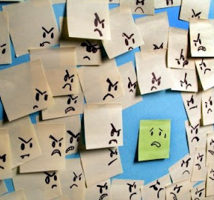
How does peer pressure feel?
How did the volunteer feel having everyone pressuring him or her?
What was it like for the other participants trying to pressure someone?
Did the volunteer change his/her mind?
Is it easy to stand for what one believes?
How does it feel to give in under pressure?
Notes:
Activity: Peer Influences Continued
Debrief using the following questions:
How did the volunteer feel having everyone pressuring him or her?
What was it like for the other participants trying to pressure someone?
Did the volunteer change his/her mind?
Is it easy to stand for what one believes?
How does it feel to give in under pressure?

Slide 33
What is peer pressure?
The influence exerted by a peer group encouraging a person to change his or her attitudes, values, or behavior in order to conform to group norms.
Notes:
Explain that these influences are called peer pressure.
Ask student to read off definition. “Peer pressure is the influence exerted by a peer group encouraging a person to change his or her attitudes, values or behavior in order to conform to group norms.”

Slide 34
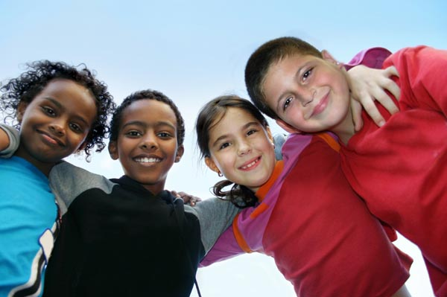
Positive or Negative?
Both!
Notes:
Ask students if they think that peer pressure is positive or negative. Explain to students that peer pressure can be positive or negative.
Someone can influence or pressure you to make positive decisions, like playing a new sport. They can also influence or pressure you to make a bad decision, like going somewhere you don’t want to go.
Ask students for examples of positive peer pressure (Answers: Trying something new like playing a sport together or joining a club together, not smoking, eating healthier food)
Ask students for examples of negative peer pressure (Answers: Trying smoking or alcohol when you don’t want to, going some place that your parents told you not to go to)

Slide 35
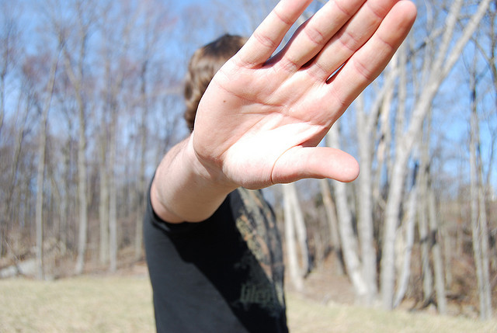
Three Models of Assertive Refusal
Say “no” firmly and keep repeating it.
Take the offensive. Let the person know how the continued pressure makes you feel.
Refuse to discuss the matter any further. Leave.
Notes:
Explain to students, we’ve talked about how our peers can influence us at any age from very young to adulthood. We’ve talked about how peer pressure can be both positive and negative. And we’ve seen how peer pressure feels for both the person being pressured and the person doing the pressuring. Everyone needs to have the tools to resist negative peer pressure. One method that has been shown to be effective is the three assertive techniques model.
Ask student to read off the three assertive refusal techniques.
Saying “no” firmly and keep repeating it.
Take the offensive. Let the person know how the continued pressure makes you feel.
Refuse to discuss the matter any further. Leave.
Distribute “Three Techniques for Assertive Refusal” (pg 11 in Teacher’s Guide)

Slide 36
Activity: Role Play
Notes:
Activity: Role Play
Time: 20-30 minutes
Materials Needed: Role-Play Situations for Peer Pressure (pg 12 of Teacher’s Guide) (1 per group)
Directions:
Divide students into four groups. Give each group one of the cards from “Role-Play Situations for Peer Pressure” (Appendix 3).
Ask them to develop two role-plays – one demonstrating negative peer pressure, the other demonstrating positive peer pressure. Give them 15 minutes to develop role-plays. Encourage students to portray realistic (and appropriate) language and interactions. Instruct them that role-plays should have a positive outcome (i.e. the student makes a healthy decision whether the peer pressure is positive or negative.)
Reconvene the class. Have each group demonstrate a negative and a positive role-play.
Ask students watching the role-plays to comment on the outcome:
How did the person being pressured react?
How did the person pressuring react?
Would the person regret what they did later?
How will these characters feel about themselves after this situation?
Ask students participating in the role-play:
How did the person being pressured feel?
How did the person who was doing the pressuring feel?
What will they do if they are ever in this kind of situation?

Slide 37
Why is it difficult to resist negative peer pressure?
Notes:
Ask students, “Why do you think it is difficult to resist negative peer pressure?” (Answers: You want your peers to like you, you feel left out or un-cool if you don’t)
Optional: If you have time, brainstorm some ways to overcome these negative feelings.
Example: You want your peers to like you: If you feel pressured by your friends to do things that you feel are not right, it may be time to seek out new friendships. True friends will respect your decisions, and support you.
Example: You feel left out or un-cool: It is your decision whether you do something or not. If something does not feel right to you, don’t do it. Take pride in the fact that you are sticking up for yourself and following your moral compass. It may be difficult, but know it’s brave and far cooler than giving in to negative peer pressure and feeling bad about it later. It is important to realize even if you have given into peer pressure before and done something you did not want to do, you can prepare yourself to say no the next time-you don’t have to repeat a mistake!

Slide 38
How does it feel when you are successful?
Notes:
Ask students, “How does it feel when you are successful at resisting negative peer pressure?” (Answers: proud, like you stood up to yourself, brave, a little left out)

Slide 39
!
?
!
?
!
Questions
!
!
?
?
Notes:
Remember that peer pressure is something that we will have to deal with all our lives. Challenges yourself to be a positive influence on your classmates today.
If doing anonymous questions, remind students to keep writing down any questions that they may have that they want to ask in private. Collect questions in the box. Either draw questions directly from the box and answer them in class, have another question session at a later date, or create an “answer sheet” that students can take home with all the answers on it.
If giving homework distribute “Peer Pressure: Then and Now” (pg 13 of Teacher’s Guide). Explain to students that they should ask a parent or other adult to tell them about a time when they felt pressured by peers and what they did in the situation.

