Slide 1
Changes & Influences during Puberty
This presentation was adapted for use in Chatham County Schools by the Chatham County Public Health department from “Successfully Teaching Middle and High School Health” developed by the North Carolina School Health Training Center.
Leading the Charge to a Healthier Chatham.
Chatham County Public Health Department • L. Layton Long, Health Director • www.chathamnc.org/publichealth
Notes:
Today we will talk about changes that happen as part of growth and development. These changes are called puberty and all boys and girls experience it as they become men and women. Explain to students that first we will do an activity to get us thinking about puberty.
If doing anonymous questions, distribute questions sheets. Explain to students that they can use the sheets to ask questions that they would like to ask in private. At the end of the class, everyone will put a sheet in the box, that way we have no idea who asked what question. Either draw questions directly from the box and answer them in class, have another question session at a later date, or create an “answer sheet” that students can take home with all the answers on it.

Slide 2
Activity
Puberty Walk
Notes:
Warm-Up: Puberty Walk
Time: 7-10 minutes
Materials Needed: None
Directions:
Ask students to move to one area of the room.
Tell them that you when you tap them on the shoulder they should walk (not run) to a designated location on the opposite side of the room. Note: If you have a large group or would like the activity to take less time, ask for a smaller group of volunteers.
Tap students on the shoulder, starting with one student. Let the first student walk to the other side of the room, then tap another student. Continue tapping students, first slowly, then and speeding up and tapping groups and individuals. Toward the end, slow down, again tapping individuals. Leave a few students to walk across alone at the end.
When all students have walked to the other side of the room, ask students:
How did it feel to be the first one to walk?
How did it feel to be the last one to walk?
Did it feel better to walk alone or in a group? Why?
Lead a discussion using the students’ answers to make the transition that this walk is very much like puberty- Just like everyone eventually walked across the room, eventually everyone will go through puberty. Some people start earlier and will finish before their peers, others will start later. And just like everyone walked at a different pace across the room, everyone moves through puberty differently.
Puberty is defined as development of secondary sex characteristics (such as pubic hair) and the beginning of reproductive capacity (being able to become a parent).
Adolescence is the transition from childhood to adulthood. These changes are exciting and fun, but at other times can cause a young person to become confused and awkward. There are social and emotional changes as well as physical ones. Remember each person goes through puberty and adolescence at his/her own pace.
Transition by telling students that we will now discuss the physical and emotional changes that happen during puberty.

Slide 3
pu·ber·ty noun \ˈpyü-bər-tē\
A time in your life when your body makes changes that causes you to develop into an adult.
Notes:
Tell students, you are all at a very important time in your reproductive development. Many of you who have older brothers, sisters or cousins may have noticed that they have experienced changes in the way they look. They have begun to look more like young men and women and less like children. These changes may have already started for you or they may be beginning within the next several years.
It is fairly common for children to feel a little awkward during this time. Just as the physical changes occur over several years, so might those feelings of being uncertain and uncomfortable. Just realize that as a child’s body changes and matures, so does his or her feelings about growing up. Eventually all of us had to accept these changes because they are part of growing up.
Today we are going to talk about some of those changes that occur as your body develops from a child to an adult. Sometimes children (and adults) feel uncomfortable talking about puberty. It is natural for folks to feel a little embarrassed, especially if they have not talked about these topics before. They may feel silly and may giggle or get quiet. That’s to be expected and we’re okay with a little of that in class.
Today we will also discuss puberty and the reproductive system. Some of you may know a lot about these things, while others may not have seen or heard about this before. Make sure to ask questions if you have them, because chances are if you have a question someone else does too!

Slide 4
!
?
!
?
!
Changes
!
!
?
?
Notes:
As I said, today we are going to talk about the changes that come with puberty. You might be wondering now, what kind of changes?

Slide 5
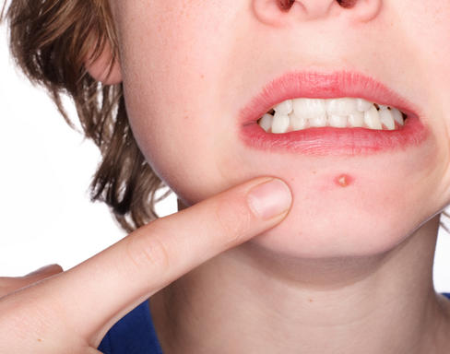
PHYSICAL
EMOTIONAL
Notes:
There will be many changes that come with puberty, both physical changes and emotional changes. These changes are often exciting and fun, but at other times can cause a young person to become confused, awkward, or embarrassed. There can also be social changes that happen during puberty, and you may find that your friends and friendships change. This is all normal, and as we discussed with our first activity, will happen at different times in everyone’s life.
Before we talk about some of the physical changes that happen to our bodies during puberty, we will first review the parts of the reproductive system. The body is comprised of several systems such as the digestive system, the skeletal system, and the circulatory system. A system is made up of organs which work together to perform a vital function. Today we are going to discuss the reproductive system for both men and women.
Some of you may know a lot about changes related to puberty, your body, and the reproductive system, while others may not have seen or heard about this before. The reproductive system works to make it possible for a man and a women to conceive a child, called pregnancy. Men and women are born with organs that will develop and eventually function to create a human life. In both males and females, the outside parts of the reproductive system are called the genitals.

Slide 6
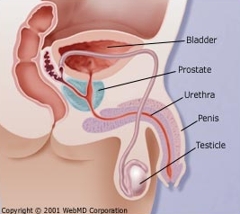
Male Reproductive System
Bladder
Prostate Gland
Urethra
Penis
Testicle
Vas Deferens
Epididymis
Scrotum
Notes:
Let’s now look at the different organs that make up the male reproductive system so we all know what we are talking about today and are on the same page.
Review each of the following organs and their functions. Have students say each organ as you review. Address any misconceptions and questions:
Bladder: The bladder is in the picture but not actually part of the male reproductive system, but is shown in this diagram for reference. Who can tell me what the function of the bladder is in both men and women? (Answer: To store urine as part of the urinary system)
Prostrate Gland: The prostate gland is one of several glands in the male system which secrete fluid to make up semen. Semen carries sperm along with a mixture of fluids created by the prostate gland and other organs.
Urethra: Like the bladder both males and females have a urethra. The urethra is a tube-like organ which carries urine from the bladder away from the body in both males and females. In males, the urethra also carries semen from the body. Urine and semen cannot travel through the urethra at the same time.
Penis: Next is the penis which lies outside the body.
Testicles: The testicles are the male reproductive organs which also lie outside the body. The testicles produce sperm.
Scrotum: The scrotum is a pouch which contains the testicles outside the male body. The scrotum helps to regulate the temperature of the testicles, which is important for the production of sperm.
Epididymis: The epididymis (ep-pid-di-e-mis) is a tightly coiled, skinny tube that is about six meters in length. This is where the sperm mature before being released from the male.
Vas Deferens: The Vas Deferens are tubes that carry sperm from the epididymis (ep-pid-di-e-mis) to the penis. If you remember from before, sperm join with fluids from the prostate gland and other glands to form the liquid, semen, which is transported by the Vas Deferens.

Slide 7
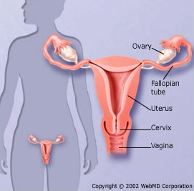
Female Reproductive System
Ovary
Ovaries
Fallopian Tube
Fallopian Tubes
Breasts
Breasts
Uterus
Uterus
Cervix
Cervix
Vagina
Vagina
Labia
Labia
Notes:
Let’s now look at the different organs that make up the female reproductive system so we all know what we are talking about today and are on the same page.
Review each of the following organs and their functions. Have students say each organ as you review. Address any misconceptions and questions:
Ovaries: The ovaries, are the female reproductive organs that produce eggs or ova. Once a girl reaches puberty, her ovaries release one egg each month, which is called ovulation.
Fallopian Tubes: The fallopian tubes are the connection between the ovaries and the uterus. If you look at the diagram, you can see the two fallopian tubes that connect the ovaries on either side of the uterus to the uterus.
Uterus: The uterus is a muscular organ where the baby develops during pregnancy. The uterus is sometimes also called the womb. When you get your period, your period comes from the uterus.
Cervix: Next is the cervix, which is the lower end of the uterus. This tight muscle holds a baby in the uterus during pregnancy.
Vagina: The vagina is the muscular tube between the uterus and outside the female body.
Labia: The labia is the padded area around the opening of the vagina in the female. While you cannot see the labia in this diagram, they are the outer most part of the female reproductive system.
Breasts: The breasts are mammary glands which produce milk in females for human babies. The diagram shows where breasts are located on the human body.

Slide 8
BOYS
GIRLS
Testosterone
Estrogen & Progesterone
Between ages 10-15
Voice deepens
Penis & testicles grow
Shoulders broaden
Hips narrow
Chest Hair
Nocturnal emissions
Growth spurt
Oily skin and scalp
Sweat
Body odor
Body hair grows
Acne
Between ages 9-13
Hips widen
Breasts enlarge
Vaginal discharge
Begin menstruation (period)
Notes:
For both girls and boys, the changes related to puberty are triggered on by hormones. A hormone is a chemical released by the body. Hormones act as messengers. They send messages from one part of the body to another. All living things have hormones. There are many different kinds of hormones. Each gives a different signal to the body. The hormones released during puberty are responsible for signal the body to start the changes from child to adult. For girls, there are two hormones responsible for puberty, estrogen and progesterone. For males, there is one, testosterone.
During puberty, your body is changing from being a child to being an adult in preparation to be able to reproduce, or have a child one day. Here are some of the physical changes that happen during puberty, as the body is transitioning from childhood to adulthood:
For boys, puberty usually happens a little later than girls, with most boys starting between the ages of 10-15 years old. Remember, that puberty is different for everyone and that this is just a range, some people may start earlier and others may start later. During puberty the hormone testosterone causes boys’ voices to get deeper, their shoulders to broaden and their hips to narrow. Boys will also start growing chest and other facial hair, their penis and testicles develop more, and they may experience nocturnal emissions, or what are known as wet dreams.
For girls, puberty usually happens earlier than for boys, between the ages of 9-13 years old. In girls, the hormones estrogen and progesterone cause changes like widening of the hips, enlargement of the breasts, and the beginning of monthly menstruation, also called your period. Girls can also experience vaginal discharge during this time.
In both males and females, increased levels of hormones in the body can cause growth spurts, oily skin and scalp, increased sweat and body odor, increased body hair and acne.

Slide 9
EMOTIONAL & SOCIAL
Notes:
Just as those hormones create changes in the way your body looks on the outside, they also create changes on the inside. While your body is adjusting to all the new hormones, so is your mind. During puberty, you might feel confused or have strong emotions that you've never experienced before. You may feel anxious about how your changing body looks. You might feel overly sensitive or become easily upset. Some teens lose their tempers more than usual and get angry at their friends or families. Other emotions may include: aggressive, moody, mixed feelings, and being sentimental.
You might have new, confusing feelings about these changes— and lot of questions. The adult hormones estrogen and testosterone are signals that your body is giving you new responsibilities, like the ability to create a child. That's why it's important to get all your questions answered. Some teens can talk to their parents about and get all their questions answered. But if you feel funny talking to your parents, there are many other people to talk to, like your doctor, a school nurse, a teacher, a school counselor, or another adult you feel comfortable talking with.

Slide 10
Remember…
Puberty is a time of changes
We all have our own body clock
Changes can be physical and emotional
It’s not a race
Notes:
Summarize, the bottom line is that puberty is a time of changes. These changes are different for everyone. Each person will start puberty at a different age, based on their own body clock. Girls may start noticing changes any time between about ages 8 or 9 to 13. Boys, on average, start noticing changes a little later, between about ages 9 or 10 to 15. And puberty isn’t an overnight process; it can take several years to complete. Puberty takes longer in boys, on average, than girls.
Remember that puberty involves changes in not only your body but also your feelings and relationships. So your friend’s body might start maturing first, but you may be maturing emotionally and socially sooner than your friend.
And it isn’t a race, anyway! We all will eventually develop when our bodies are supposed to develop.

Slide 11
!
?
!
?
!
So what can you do?
!
!
?
?
Notes:
Puberty, and the changes that come with puberty, are natural and everyone experiences them at some point. These changes are exciting and mean you are becoming your adult self.
During this time, it is important to take care of your body. There are some things that you can do that help to keep you healthy during puberty.

Slide 12
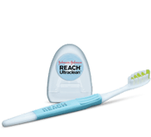
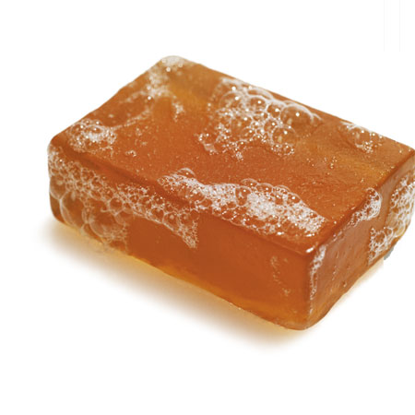
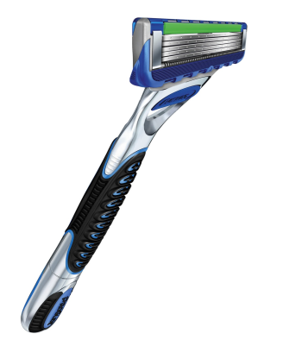
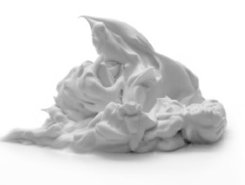
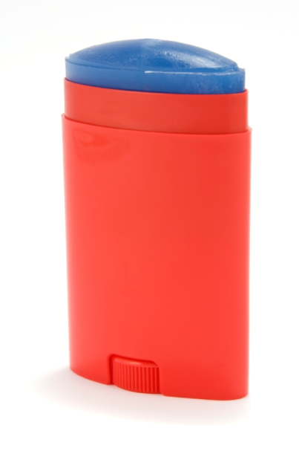
#1: Practice good personal hygiene!
Notes:
Interactive option: To make this slide more interactive, instead of the reading speaker notes ask students to identify each item on the slide. Have them think back to the changes they learned about and why each item is important when going through puberty. Use the speaker notes below to clarify and further explain that students’ explanations.
Interactive option: In addition to the pictures on the screen it may be helpful to have example items to show students.
One thing you can do is practice good hygiene. Hygiene is a fancy way of saying: be clean and healthy! Remember some of those changes we talked about, like oily skin and scalp, sweat and body odor, body hair and acme, well they make it even more important to be clean. This slide shows some different tools to help you stay clean as your body goes through these changes.
Because of the increased oil on your skin and hair, it’s important to wash your hair and body regularly. Wash your body, including armpits and other “hidden” areas like behind your ears and belly button with a mild soap. Wash your hair with shampoo. It will also become more important for you to wash your face regularly. (Have students demonstrate washing behind their ears, etc.)
Oily skin during puberty can lead to acne. Acne is a skin condition that occurs when your hair follicles become plugged with oil and dead skin cells. Acne most commonly appears on your face, neck, chest, back and shoulders. Acne can be distressing. There are many products sold at the local drug store that can help prevent or treat acne. Washing your face regularly with face wash can help prevent. And there are spot treatments, like creams, that you can put on pimples when they become inflamed. Ask an adult to come with you to the drug store to look at the different products. What works best for some people, may not work for others, so you may have to try a few products until you find one that helps keep your skin clean and clear.
To help with body odor and sweat, when you are done showering, use deodorant to control sweat and body odor. It is also a good idea to reapply deodorant after playing or exercising.
Another change we mentioned is increased body and facial hair. Some girls and women choose to shave their legs and underarms. If you decide to shave, you can use a razor with shaving cream or gel. You should always consult and adult before shaving, they can show you the proper way to shave to prevent cutting yourself.
As always, it is important to brush 2-3 times a day and floss your teeth at least once a day. (Also you should use mouthwash too!) . Many of you have all or most of have your permanent teeth now, these are the only teeth you get for the rest of your life! Make sure you take care of them!
All of the items can be found at the dollar store, drug store and Walmart.

Slide 13
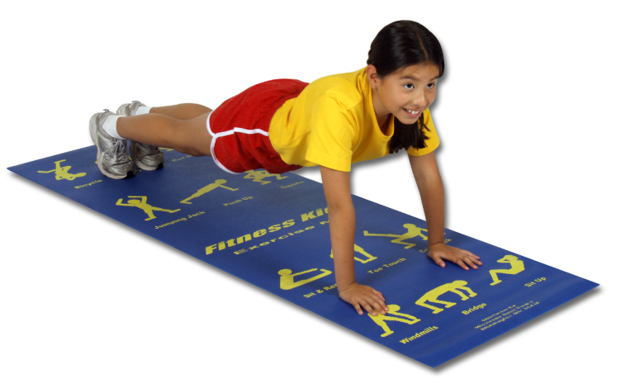
#2: Be Healthy!
Notes:
Another important thing to do is to be healthy. This is an important time, your body is growing and changing, it is also a good time to start healthy habits. The habits you start now will impact how your body grows during puberty, and will help you stay healthy for the rest of your life!
One very important healthy habit, it is to eat healthy foods. During puberty, you might find you are more hungry, this is normal, because your body is growing and making changes. Just make sure that you fuel your body with good things. This means eating a full “MyPlate.” Ask students, Can anyone tell me the five sections of “MyPlate”? Ask students for an example of a healthy item from each section. (Examples: fruit- banana, apple, strawberry; vegetable- broccoli, carrots, lettuce/salad; grains- bread, popcorn; protein- chicken, beans, steak; dairy; cheese, milk, yogurt). As students answer, remind them of the following- fill half your plate with fruits and vegetables; look for whole grain products; choose low-fat proteins and dairy products. Remember to safe fatty foods, such as fried foods, and sweets for special occasions.
Another healthy habit to keep in mind as your body grow and changes is eating breakfast. You should also make sure you eat a good breakfast, this kick starts your body and helps give your body the energy to make it through the day. Ask students for examples of healthy breakfasts. (Example: whole wheat toast with peanut butter, fruit or fruit juice such as OJ, yogurt, or whole wheat cereal).
It is also important to drink 6-8 glasses of water a day and limit sugar-sweetened beverages like sweet tea, sodas, and energy drinks. These drinks are okay every once in a while, for special occasions, but not everyday.
It is also important to move your body. As your body undergoes changes during puberty, you want it to grow into a strong adult body, so make sure that you get plenty of physical activity. It is recommended that you get 60 minutes of physical activity a day, that means 60 minutes of any activity that raises your heart rate and makes you breathe a little hard. This doesn’t have to be 60 minutes straight, you can have 10 minutes here, 30 minutes there, but it should all add up to 60 at the end of the day.
Physical Activity Break: If you have time, this is a good time to pause for a physical activity break. See note in “4th-5th Grade Puberty and Hygiene Teacher’s Guide.”

Slide 14
#3: Get good information.
#3: Get good information!
Find Info: ● www.teenshealth.org/teen/
● www.ubykotex.com/get-the-facts
Notes:
As we’ve talked about, puberty is a time of a lot of changes, and you may have a lot of questions. There are lot of people and sources of information out there. Some of that information may be good information, but some of it may be confusing or false. It is important to know where to look for information, and how to determine if it is good information or not.
The internet can be a great resource, but it can also have lots of false information. For more information on hygiene, puberty and the reproductive system we recommend the website http://teenshealth.org/teen/. The site https://www.ubykotex.com/get-the-facts is a great resource to get information your period.
Parents are also good sources of information. But if you feel funny talking to your parents, there are many other people to talk to, like your doctor, a school nurse, a teacher, a school counselor, or another adult you feel comfortable talking with.
You will probably also talk to your friends about these changes, and this is a really great resources because friends can provide emotional support. Just remember that your friends are going through the same things that you are, and may not have all of the correct information. Always check information you learn from your friends with a trusted adult or other reliable source, like teenshealth.org and ubykotex.com.

Slide 15
REMEMBER
It will be okay!
Everyone goes through it
It’s normal
Adults and friends can give support
Be clean & healthy
Notes:
Just remember that everyone goes through puberty at some point in their life. Everything you will experience is normal! Your body is developing both physically and emotionally into an adult. These changes can feel scary or confusing. But, at the same time, they can be exciting-- You are becoming your adult self! This is not a painful process. If you are feeling scared, focusing on the things you want from life, your hopes and goals, can help you stay focused. Talking with friends, family and trusted adults is another good way to stay focused throughout these changes and support you as you grow up. And remember the good hygiene and health tips that we mentioned before to stay clean and healthy during puberty.

Slide 16
!
?
!
?
!
Questions
!
!
?
?
Notes:
If doing anonymous questions, remind students to keep writing down any questions that they may have that they want to ask in private. Remember to collect questions after completing the activity/activities of your choosing.

Slide 17
Activity
Healthy or Unhealthy!?
Notes:
Activity: Healthy and Unhealthy
Time: 5-7 minutes
Materials Needed: Teachers copy of “Healthy and Unhealthy Practices during Puberty” (pg 5), Copies of healthy and unhealthy cards for each student (pg 6-7)
Directions:
Before class, copy onto two different colors of cardstock and cut apart the Healthy-Unhealthy cards for each student.
Read each statement from “Healthy and Unhealthy Practices during Puberty,” and ask students to hold up the appropriate card.
Clarify any incorrect responses using the information provided.

Slide 18
Activity
Puberty Scenarios
How does the main character feel about growing up?
What steps can you take to be a respectful friend to him or her?
Notes:
Activity: Puberty Scenarios
Time: 15 minutes
Materials Needed: Puberty scenarios (pg 8), Marker/paper or white board to write on
Directions:
Divide students into small groups and provide each group one of the Puberty Scenarios.
Instruct groups to read their scenario and answer the following questions together:
How does the main character feel about growing up?
What steps can you take to be a respectful friend to him or her?
Have each group report out their answers, making sure to highlight puberty and hygiene lessons as they come up:
Everyone experiences puberty differently
Be a respectful friend to everyone
Healthy practices that the individual could use to stay healthy
Transition by telling students that we have reviewed many of the emotional and physical changes that occur during puberty. It is an exciting time with lots of change, but can often make us nervous or scared as these changes happen. Remember that the changes happening are normal, and that you can also plan for some wonderful changes in life! We are going to talk about some of them now.

Slide 19
Activity
Planning for a Healthy Life
Notes:
Activity: Planning for Health
Time: 5-7 minutes
Materials Needed: Copies of “My Plan to Stay Healthy and Feel Good! Worksheet” (pages 9-10)
Directions:
Transition at by telling students that we have reviewed many of the emotional and physical changes that occur during puberty. It is an exciting time with lots of change, but can often make us nervous or scared as these changes happen. Remember that the changes happening are normal, and that you can also plan for some wonderful changes in life! We are going to talk about some of them now.
Distribute handouts.
Instruct students to select one health behavior that they will work on to improve their health.
Give students 5 minutes to complete the hand out.
If there is time, allow students to volunteer to share their plans.
To conclude, tell students to take home the worksheet to share with their families. If they would like, they can track their progress with their behavior on the back of the worksheet

Slide 20
What to do about your period?
!
?
!
!
?
!
!
?
?
Notes:
Interactive option: It is helpful for students during this section to show them examples of pads and tampons.
After this slide, we usually get a lot of questions about periods. We know that girls your age are starting to get their period or may soon get their period in the next few years. We want to emphasis that getting your period is normal, almost all women experience it, and you really should not feel negative about it. It means you are growing and maturing into an adult and that's exciting, so don't feel ashamed about it. Yes it can be a difficult to deal with at times but with knowledge about what to expect and how to handle your periods it can be easy.
It is important to remember to take a bath or shower at least once a day when you have your period to keep clean and reduce any odor. You also will want to buy and have ready, in the bathroom at home as well as in your locker or backpack at school, either pads or tampons so you are always prepared in case you get your period unexpectedly.

Slide 21
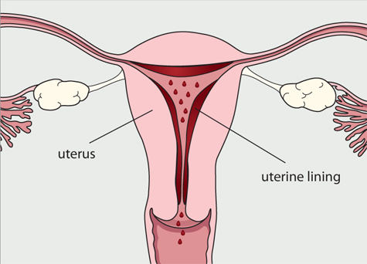
Menstruation
Notes:
Note: You may need to reference the organs and their functions (below) as you explain.
Note: This slide is animated. It is noted in the text when to click.
Lets first review what menstruation or your period really is. Each month before ovulation (release of the egg from the ovaries), the female body prepares for the possibility of pregnancy. This means that the lining of the uterus, which is called the endometrium (click), begins to thicken in case there is a fertilized egg to implant. This fertilized egg would eventually be the new baby that would grow inside a woman for 9 months until it is born.
However, if fertilization does not occur, the lining is no longer needed and thins out and leaves the body. (click) The process of this lining leaving the body is menstruation or your period. This is a normal process for girls and women during their reproductive years, and it happens each month.
___
Body parts to reference:
Ovaries: The ovaries, are the female reproductive organs that produce eggs or ova. Once a girl reaches puberty, her ovaries release one egg each month, which is called ovulation.
Fallopian Tubes: The fallopian tubes are the connection between the ovaries and the uterus. If you look at the diagram, you can see the two fallopian tubes that connect the ovaries on either side of the uterus to the uterus.
Uterus: The uterus is a muscular organ where the baby develops during pregnancy. The uterus is sometimes also called the womb. When you get your period, your period comes from the uterus.
Cervix: Next is the cervix, which is the lower end of the uterus. This tight muscle holds a baby in the uterus during pregnancy.
Vagina: The vagina is the muscular tube between the uterus and outside the female body.
Labia: The labia is the padded area around the opening of the vagina in the female. While you cannot see the labia in this diagram, they are the outer most part of the female reproductive system.
Breasts: The breasts are mammary glands which produce milk in females for human babies. The diagram shows where breasts are located on the human body.

Slide 22
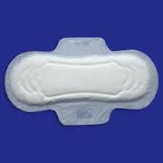
Period Supplies
Pads
Rectangles of absorbent material that attaches to the inside of a girl’s underwear and absorbs blood.
Change often, at least every 3 to 4 hours, to prevent the buildup of bacteria and eliminate odor.
Notes:
Some of you may already be familiar with the next information but we wanted to talk about what your options are. Once you get your period, you'll need to use something to soak up the menstrual blood. There are lots of choices out there, and it may take some experimenting before you find the product that works best for you.
First, lets talk about pads. Pads are placed on the inside of a girl’s underwear (there is a sticky side so it sticks to your underwear). There are many different types of pads: Super, slender, overnight, with or without wings, deodorant, maxi, mini and cloth pads. What you use will depend on how heavy your menstrual flow is and what your personal preferences are. Some pads are scented or come with a deodorant in them. Be cautious when using scented pads, these can cause irritation of the vagina or an allergic reaction in some girls.
Also, don't try to flush a pad down the toilet — even the lightest kind of pad may back up the toilet and make a huge (embarrassing!) mess. Just wrap it up in some toilet paper and throw it away in the trash receptacle found in each stall. If there isn’t one in the stall, you can place the wrapped up pad in the main trash can.
It's also possible to buy reusable pads that can be washed after each wearing — these are usually available in natural health stores or online. Some women choose to use these pads because they think they are better for the environment or because they save money. It's all a matter of personal preference. No matter what kind of pad you choose, it's best to change pads every 3 or 4 hours, even when your flow isn't very heavy.

Slide 23
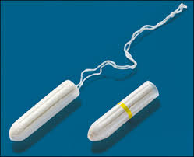
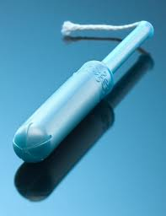
Period Supplies
Tampons
Absorbent material that is compressed into a tiny tube-like shape.
Absorbs blood from inside the vagina.
Wash hands before use and follow directions.
Change often, at least every 4-6 hours.
Notes:
Another option is tampons. Tampons are absorbent pieces of cotton that a girl inserts into her vagina to soak up the menstrual blood before it exits the body. A lot of girls like using tampons because it feels more natural and comfortable (since it is inside). Women and girls who are active and do things like swim, run, dance, or play sports especially like to use tampons during their period. Like pads, tampons come in different sizes and absorbencies for heavier and lighter periods (words like "super" or "ultra" on the packaging usually mean that a tampon is designed for girls whose flow is heavier). Tampons can also come with or without deodorant. There's no real need for deodorant in a tampon, since regular changing gets rid of any odor. The deodorant in tampons can irritate the vagina, and could cause an allergic reaction in some girls so we don’t recommend using tampons with deodorant.
It's easy to use a tampon, but you do need to learn how. After washing your hands, follow the directions that come with the tampons carefully and be sure to relax. Some tampons come with an applicator — a plastic or cardboard tube that guides the tampon into the vagina. Other tampons are inserted with the fingers.
One thing to remember about tampons: It's very important that you change them every few hours and that you wear the absorbency type that is right for you. If a tampon is left in too long, it won't get lost. But a girl may get an unusual discharge and odor, and she could develop an infection. That's why it's important to change tampons often. It is important to not that you should never put a tampon in and leave it in all day or all night, thinking that you won't need to change it because your period is so light. Once you remove a tampon it is best to wrap it up in toilet paper and throw it away in the trash receptacle found in each stall. Don't flush a tampon down the toilet — even when the box says a tampon is flushable, some tampons can still cause problems in some plumbing systems.

